Slide 1


BUILD LOW-CODE AGENTIC AI WORKFLOWS USING N8N

Slide 2


What is n8n?
n8n is a low-code workflow automation tool that allows you to connect services like Gmail, Google Sheets, OpenAI, and your own APIs using a drag-and-drop interface.
It became the world's most popular workflow automation platform for technical teams.
© All rights reserved for Dr. Ryan Ahmed @Stemplicity Inc.

Slide 3
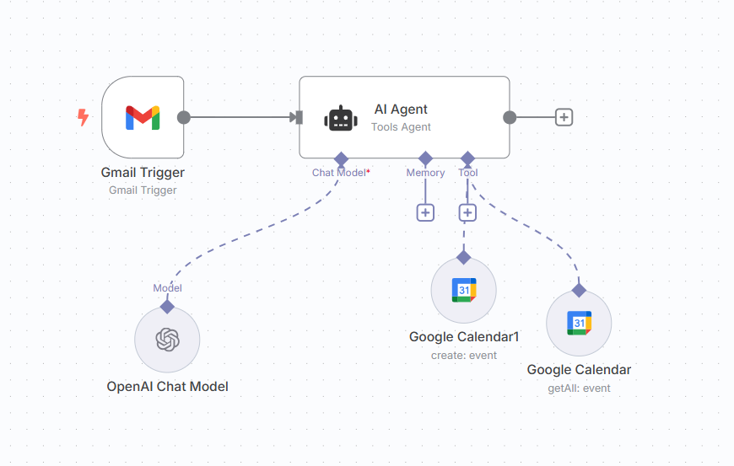
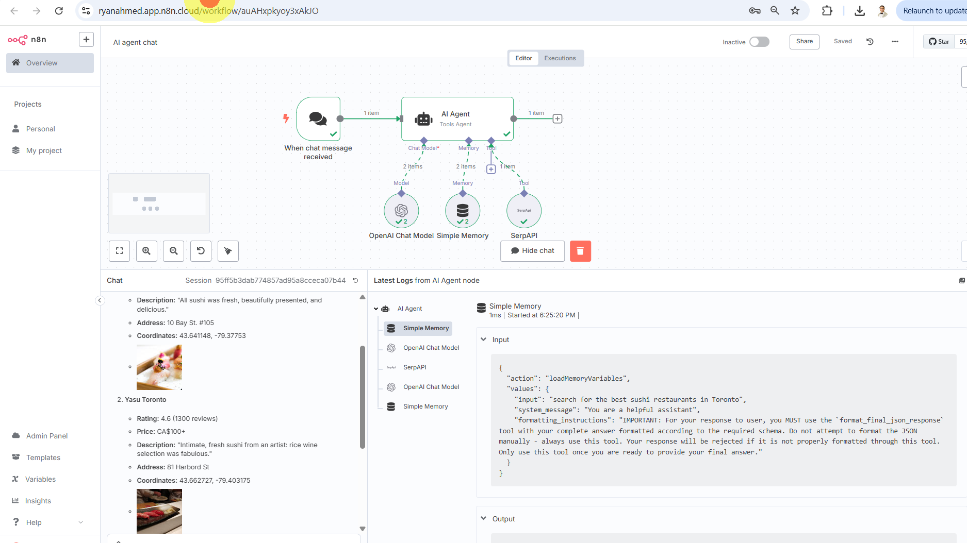
What does a typical n8n workflow look like?
© All rights reserved for Dr. Ryan Ahmed @Stemplicity Inc.

Slide 4
Key n8n Features
Connectors: Integrates with over 1000 services like Slack, Gmail, GitHub, Salesforce, Notion, and custom APIs.
Low-code + Code-friendly: Drag-and-drop interface, but you can also write custom code when needed.
Visual Building: You create workflows by connecting “nodes” (each representing a service or action) in a visual interface.
Self-Hosting for Full Control: Users can self-host n8n on their own infrastructure, such as cloud servers, virtual private servers (VPS), or on-premises hardware.
Conditional Logic: n8n supports conditional logic, error handling, & retry mechanisms, allowing users to build sophisticated workflows that can adapt to real-world complexities.
AI Integration: n8n offers native integration with AI tools, including LangChain, allowing users to add features like chatbots & QA systems without writing complex code.
© All rights reserved for Dr. Ryan Ahmed @Stemplicity Inc.

Slide 5
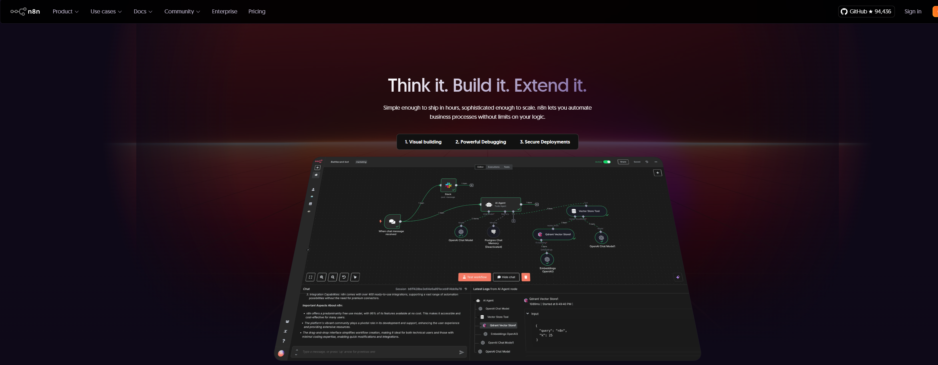
n8n Tour
Documentation: https://n8n.io/features/
© All rights reserved for Dr. Ryan Ahmed @Stemplicity Inc.

Slide 6

Key Learning Outcomes
Master how to build automated workflows using n8n.
Build Agentic AI workflows with memory, tools, and search capabilities.
Design workflows that can check calendar availability and schedule meetings automatically.
Learn how to leverage existing workflow templates in n8n.
Learn how to parse output and store it in specialized fields in a Google sheet.
Perform Email triggers in n8n and add a conditional switch.
© All rights reserved for Dr. Ryan Ahmed @Stemplicity Inc.

Slide 7
BUILD OUR FIRST N8N AUTOMATION: TEXT SUMMARIZATION ENGINE

Slide 8
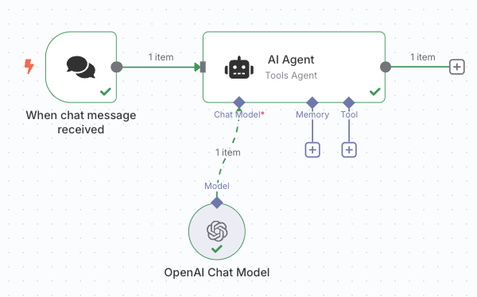
Build a Simple Chat Summarizer in n8n
AI agents are autonomous systems designed to perceive their environment, make decisions, and take actions to achieve specific goals with minimal or no human intervention. These agents are powered by advanced machine learning models, particularly large language models (LLMs), and often use reinforcement learning to adapt and improve over time. From simple rule-based bots that automate repetitive tasks like answering customer service queries or managing calendars, to sophisticated multi-agent systems that collaborate to solve complex, dynamic problems, such as financial forecasting, logistics optimization, or robotic control, AI agents are transforming the way work gets done. They can operate independently, communicate with other agents, and learn from their environment to refine their performance. In industries like healthcare, finance, and manufacturing, AI agents are being deployed to analyze massive datasets, support decision-making, and enhance productivity. As this technology matures, AI agents are expected to become integral to digital ecosystems, enabling organizations to move from automation to autonomous operations at scale.
AI agents are autonomous systems that utilize advanced machine learning, including large language models and reinforcement learning, to perceive, decide, and act independently in various sectors, enhancing productivity and decision-making while transforming operational processes.
Summarizer AI Agent in n8n
© All rights reserved for Dr. Ryan Ahmed @Stemplicity Inc.
Flow:
Chat Input (manual trigger)
Summarizer Agent (custom logic)
AI Model (e.g., OpenAI node)

Slide 9
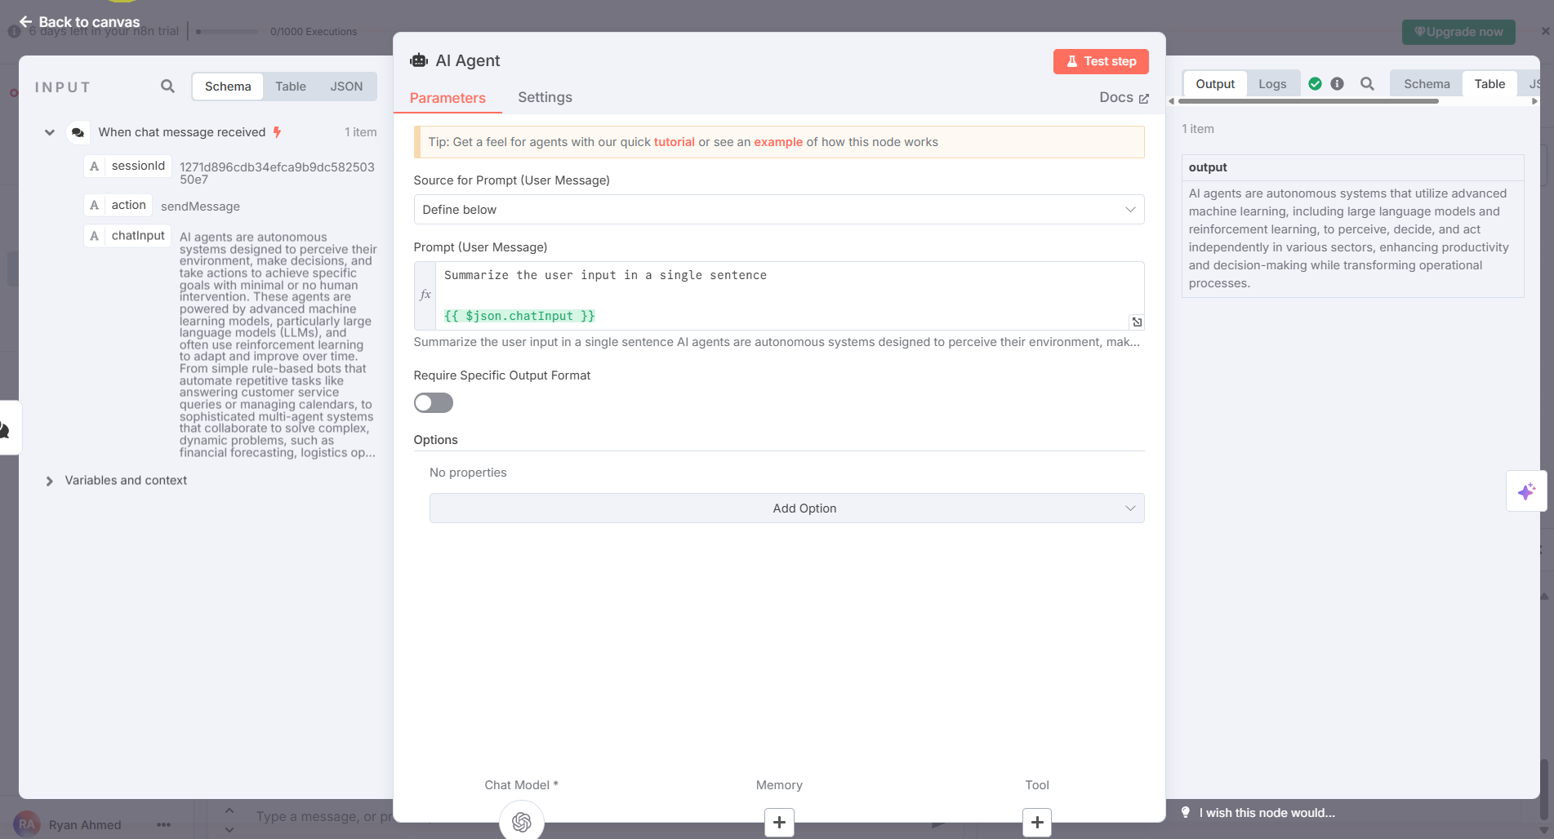
Build a Simple Chat Summarizer in n8n
Build a Simple Chat + Summarizer Agent
© All rights reserved for Dr. Ryan Ahmed @Stemplicity Inc.

Slide 10
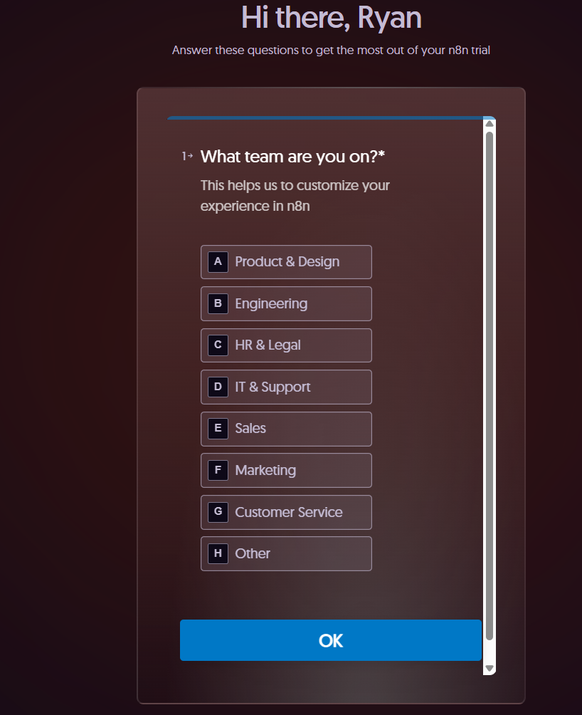
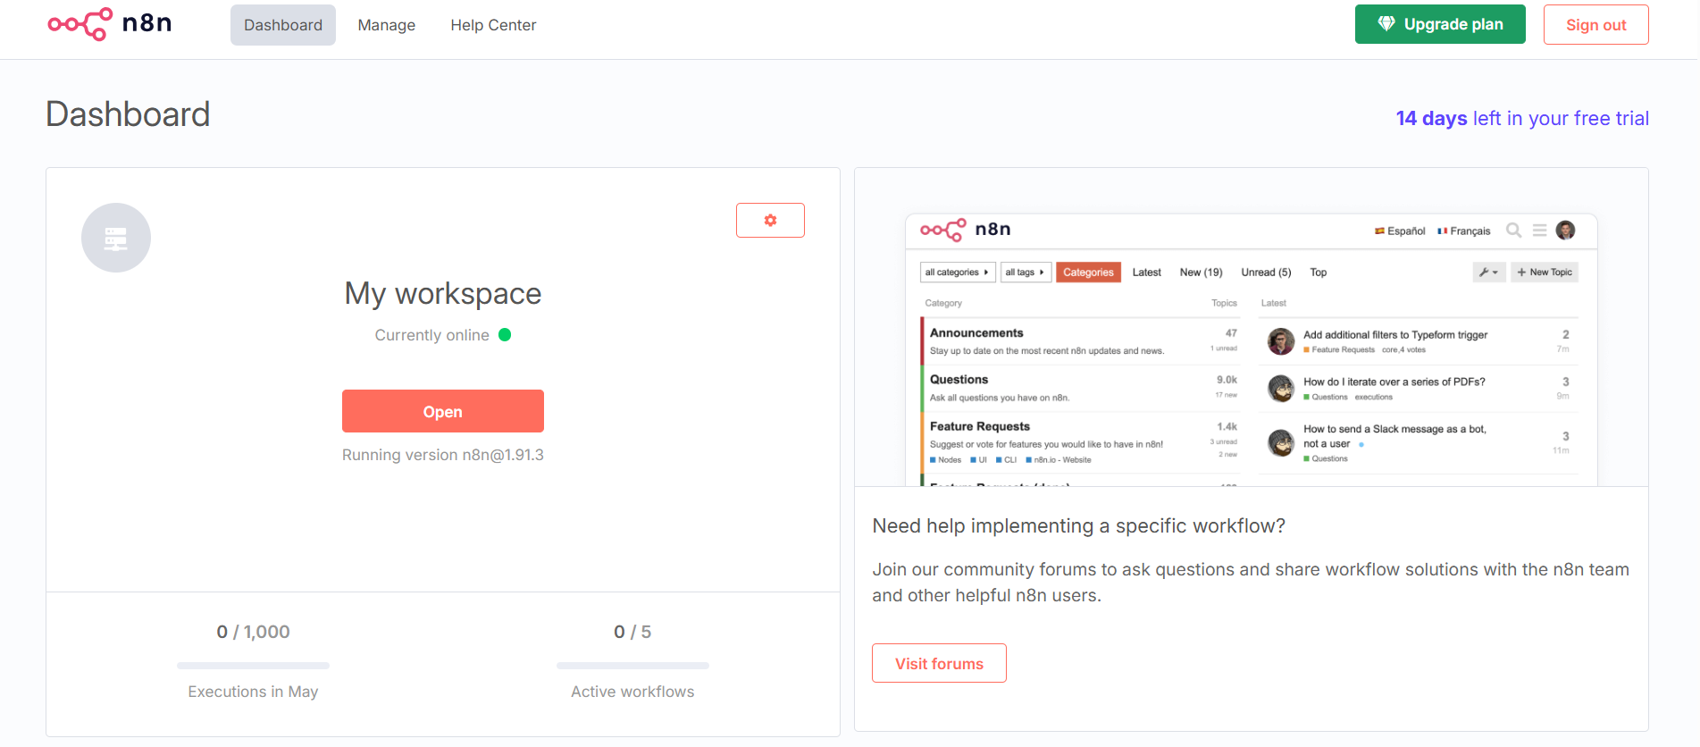
OpenAI & Google Suite Setup
Follow the steps and wait until the workspace shows active (online) which might take a few minutes.
© All rights reserved for Dr. Ryan Ahmed @Stemplicity Inc.

Slide 11
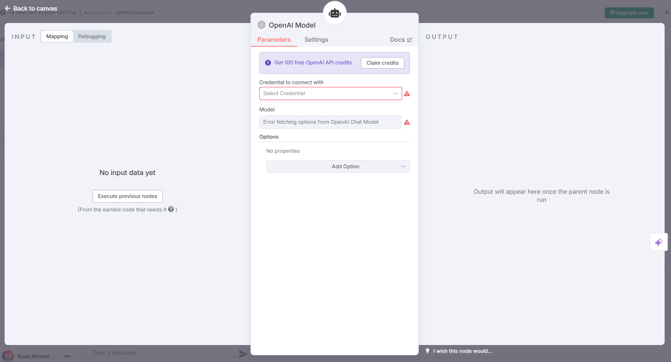
OpenAI & Google Suite Setup
Setup OpenAI API with your key.
© All rights reserved for Dr. Ryan Ahmed @Stemplicity Inc.

Slide 12
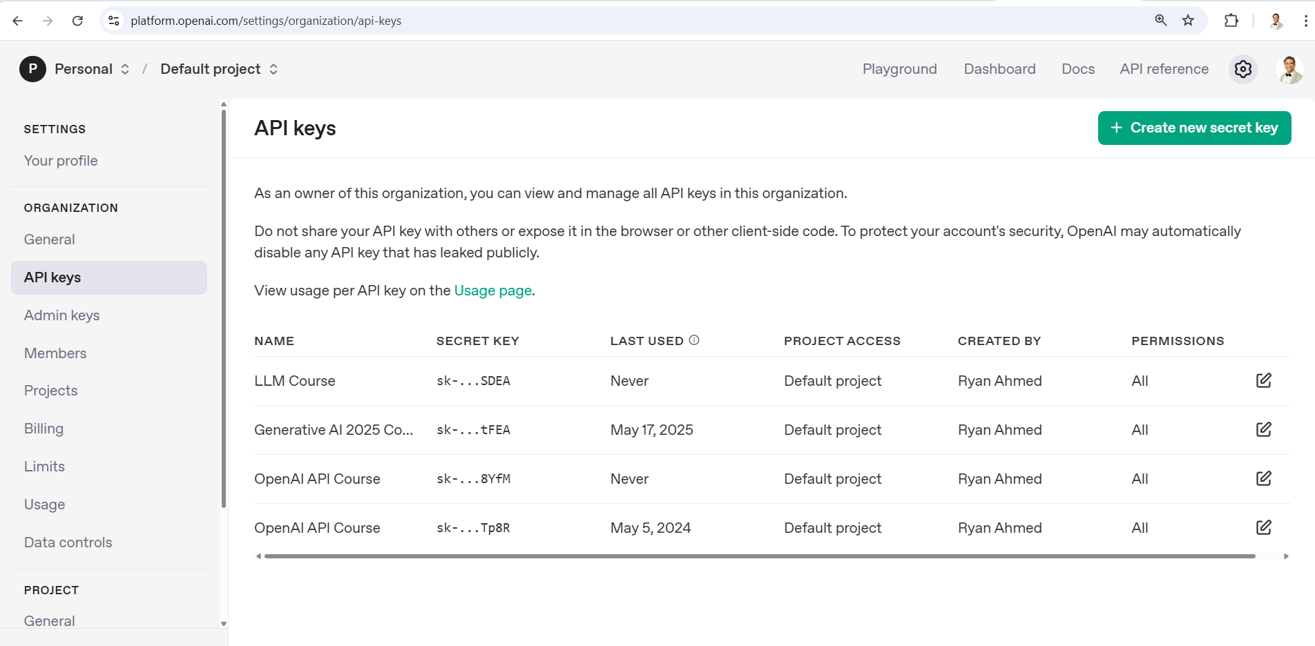
OpenAI & Google Suite Setup
Setup OpenAI API with your key.
© All rights reserved for Dr. Ryan Ahmed @Stemplicity Inc.

Slide 13
PRACTICE OPORTUNITY

Slide 14

Practice Opportunity
Automate Translation with n8n + Claude API
Setup: Create an n8n workflow that receives input text and sends it to Claude (Anthropic API) for translation to French.
Configuration: Connect Claude API
Test Input: “I am enjoying this 14-day Agentic AI and LLM Engineering bootcamp! I am learning cutting-edge skills that will transform the future!”
© All rights reserved for Dr. Ryan Ahmed @Stemplicity Inc.

Slide 15
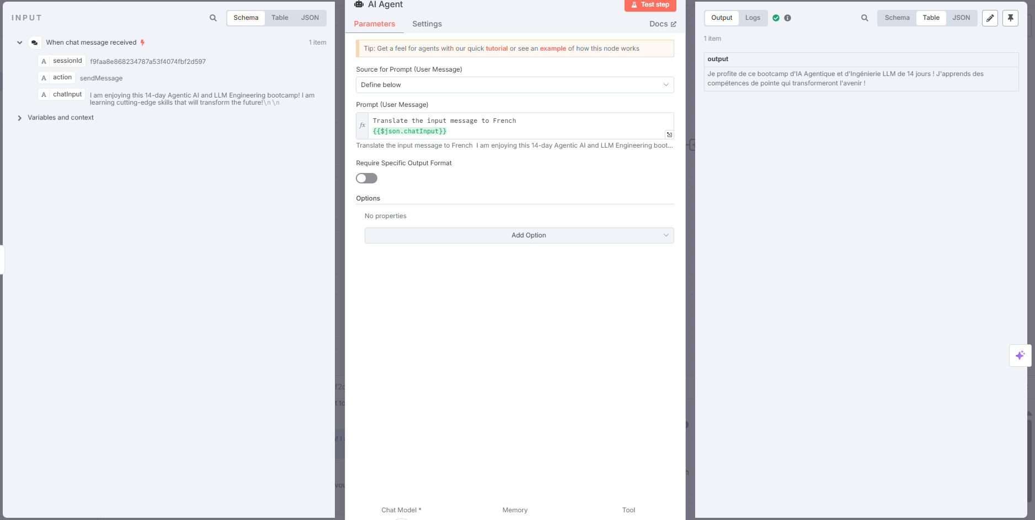
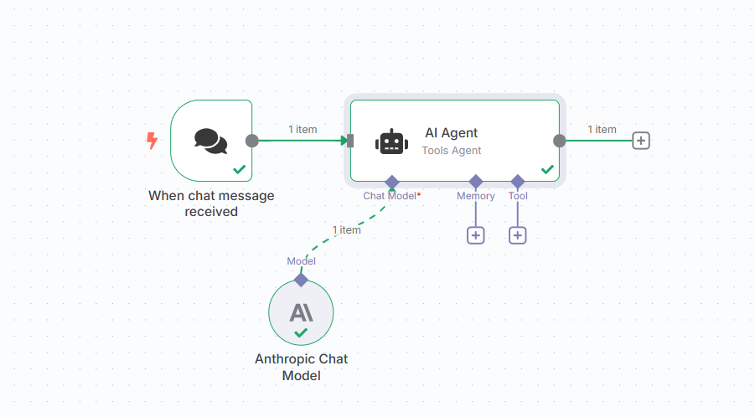
Practice Opportunity Solution
© All rights reserved for Dr. Ryan Ahmed @Stemplicity Inc.

Slide 16
USING N8N AGENTS TEMPLATE: ADDING MEMORY & SERPAPI SEARCH TOOLS

Slide 17
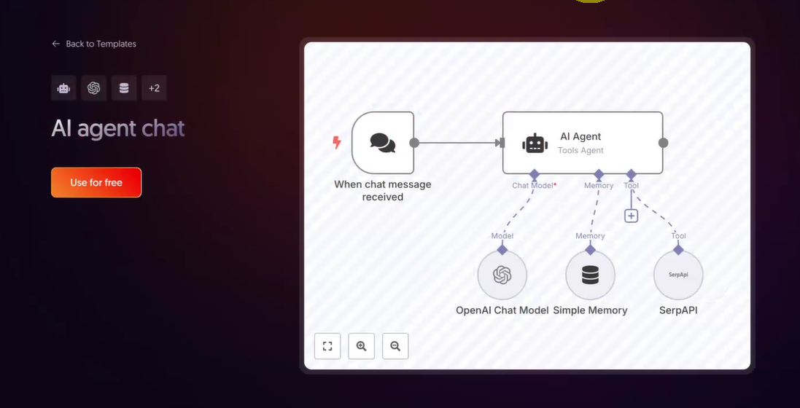
Leverage Existing Templates
Several Templates exist as a good starting point in n8n.
Let’s explore the AI Agent chat which has search and simple memory.
© All rights reserved for Dr. Ryan Ahmed @Stemplicity Inc.

Slide 18
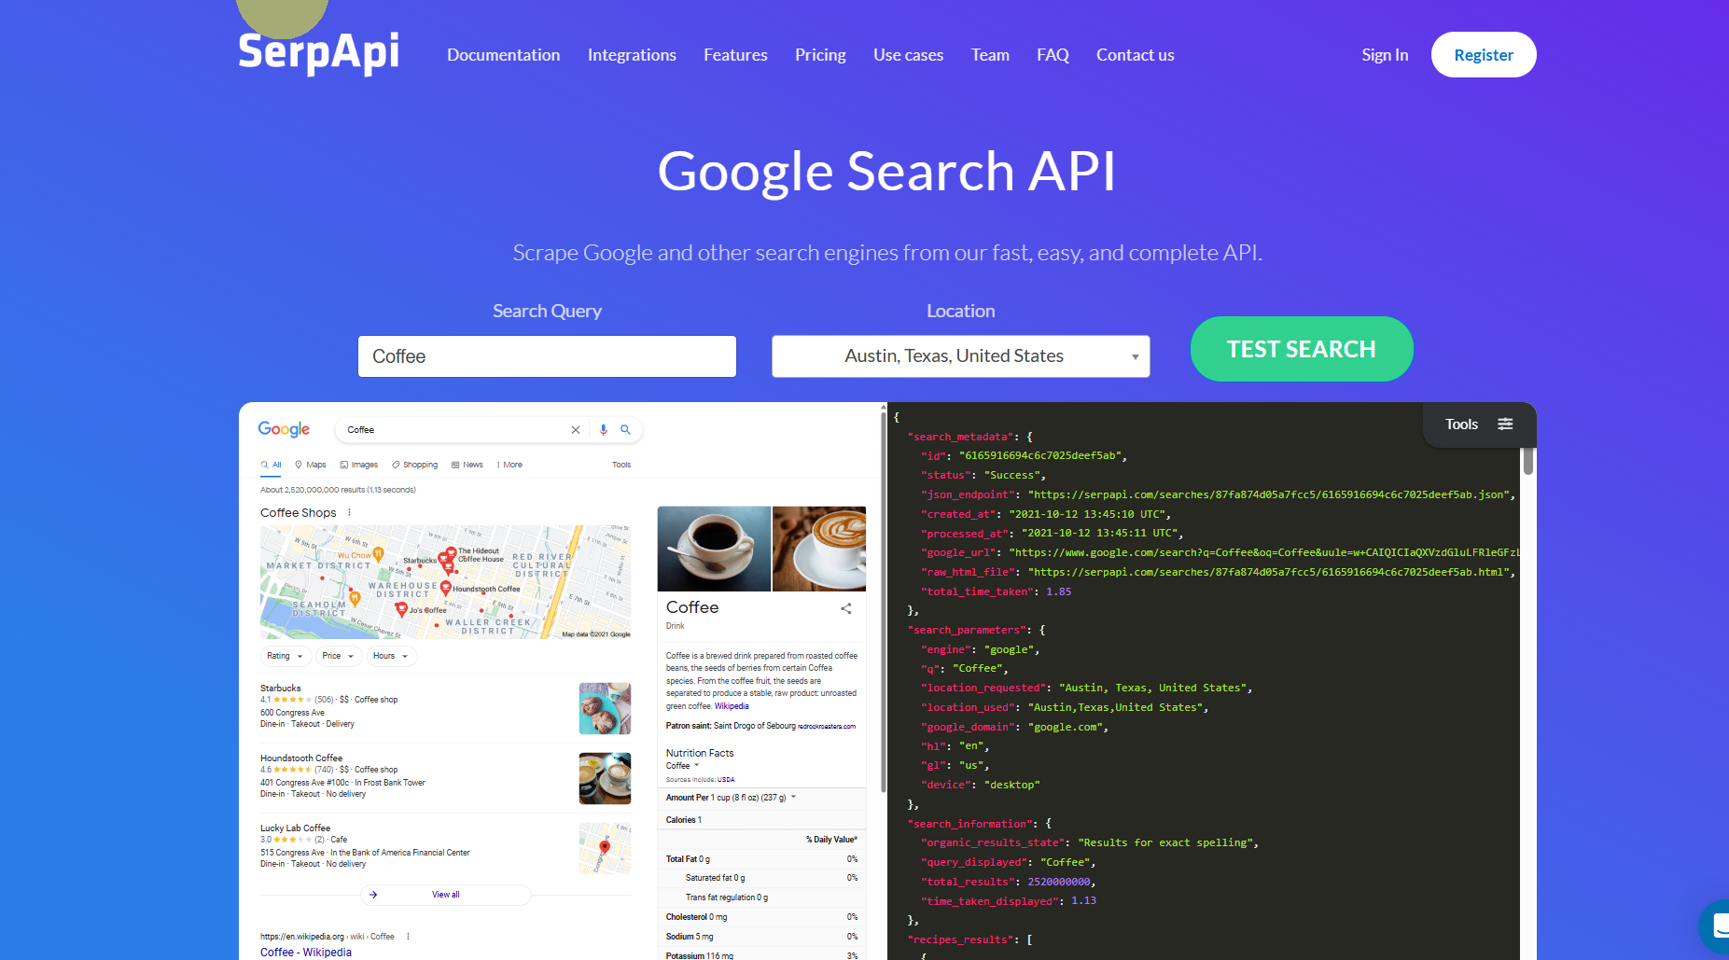
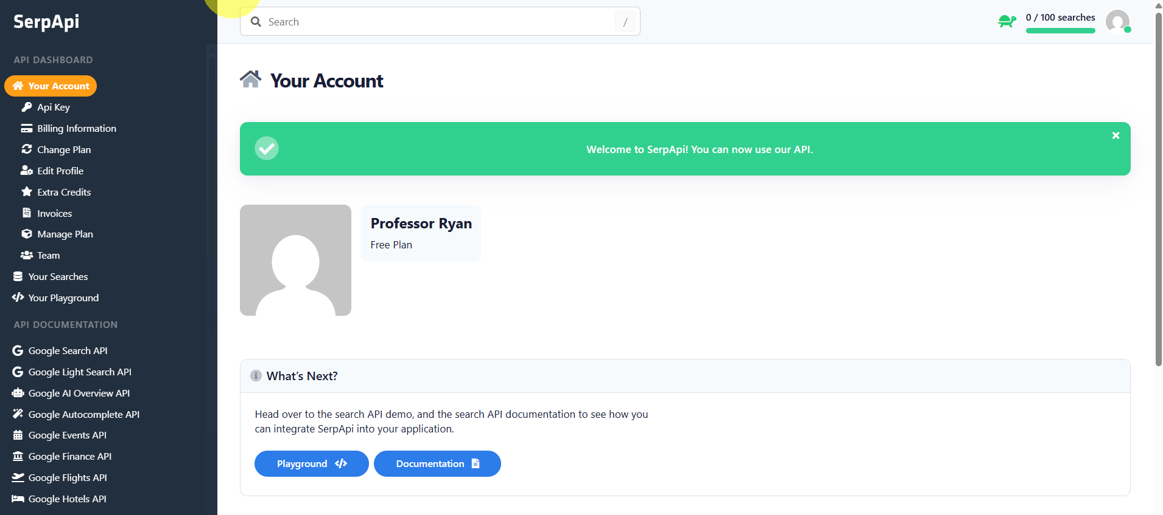
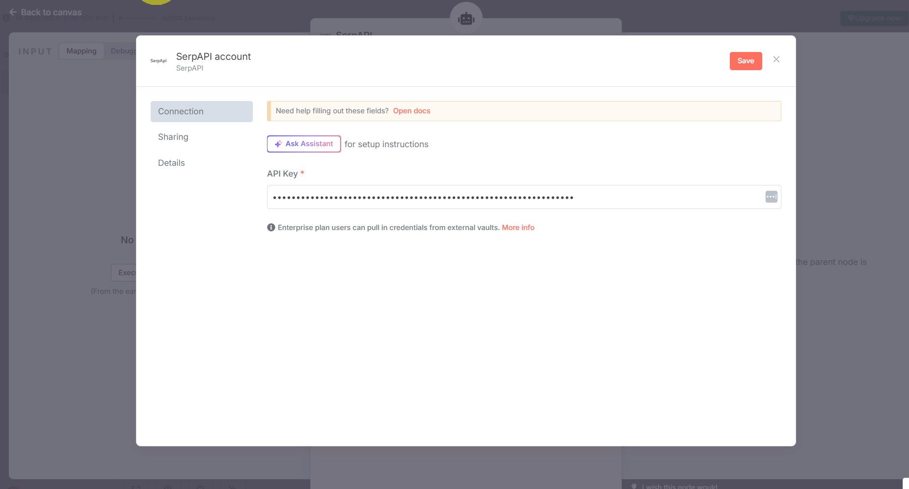
SerpAPI Signup
You will need to verify your account using both emails and phone numbers.
Copy your API key from SerpAPI site to n8n.
© All rights reserved for Dr. Ryan Ahmed @Stemplicity Inc.

Slide 19
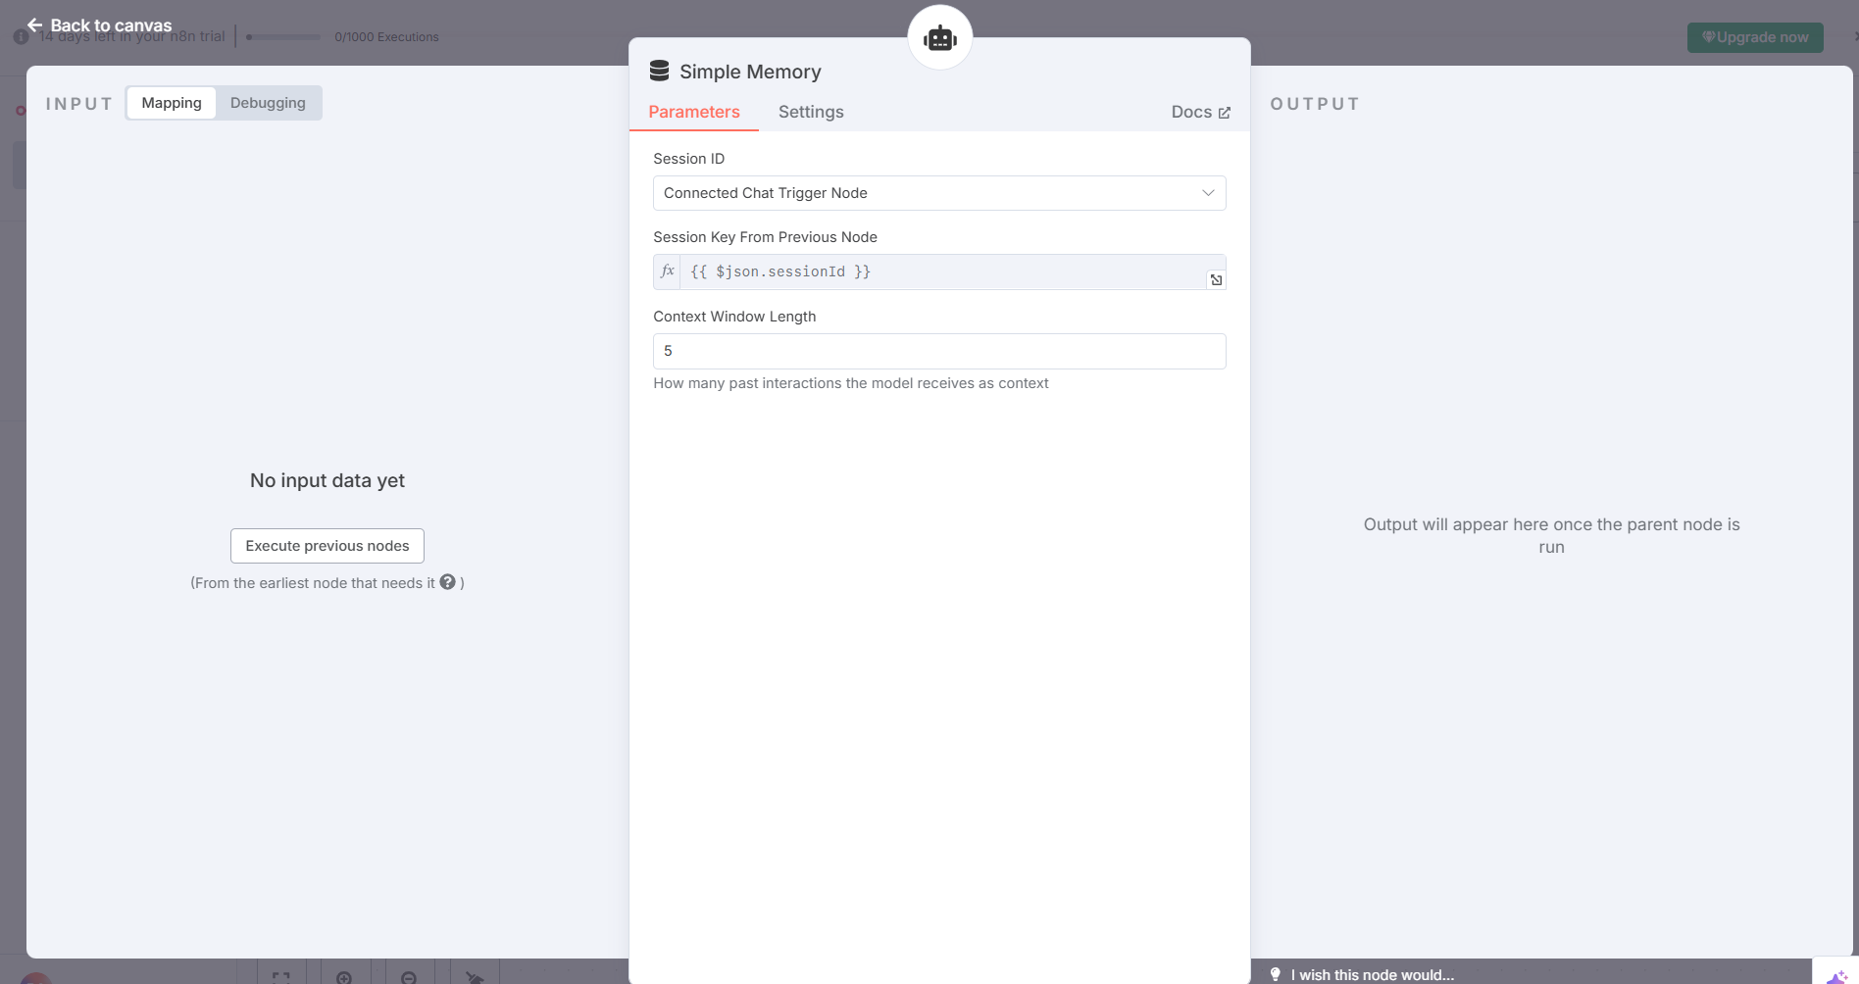
Memory
Adjust the memory context window to 5 or 10 if you prefer.
© All rights reserved for Dr. Ryan Ahmed @Stemplicity Inc.

Slide 20
Let’s test the n8n workflow
Search for the best 5 sushi restaurants in Toronto, Canada.
What about Michelin star ones?
Is this considered healthy food?
© All rights reserved for Dr. Ryan Ahmed @Stemplicity Inc.

Slide 21
PRACTICE OPORTUNITY

Slide 22
Practice Opportunity
Test the Search API to obtain current news around Bitcoin, sample questions:
How many coins are in circulation today?
What is the price of bitcoin today?
Display the price of bitcoin since 2010
Try changing the topic and ask a different question, such as list the top 5 restaurants in the world!
© All rights reserved for Dr. Ryan Ahmed @Stemplicity Inc.

Slide 23
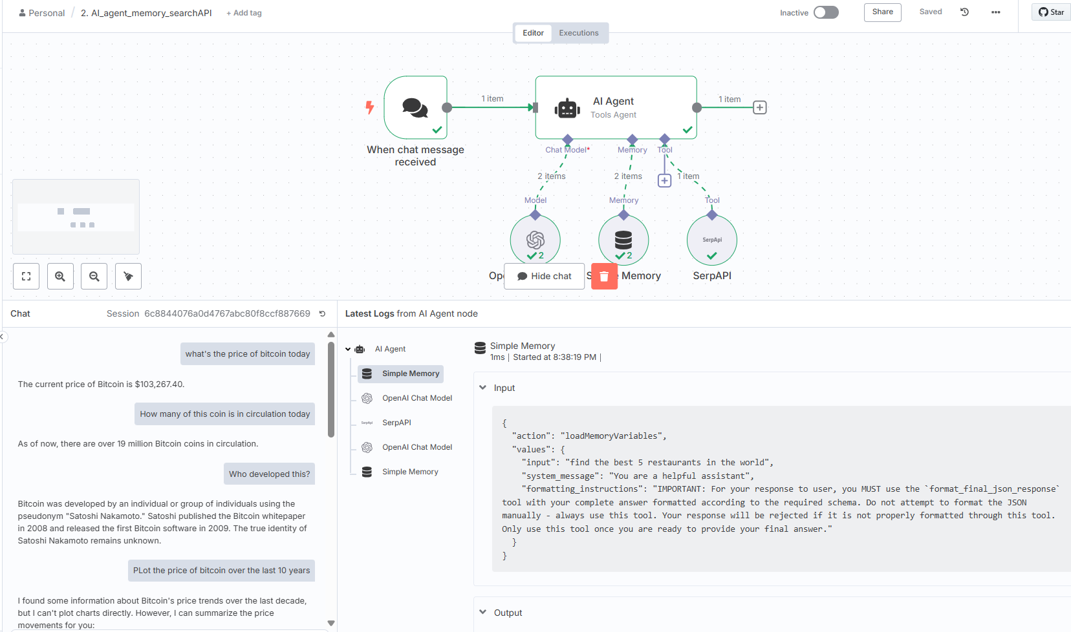
Practice Opportunity Solution
© All rights reserved for Dr. Ryan Ahmed @Stemplicity Inc.

Slide 24
N8N WITH GOOGLE SHEETS INTEGRATIONS

Slide 25
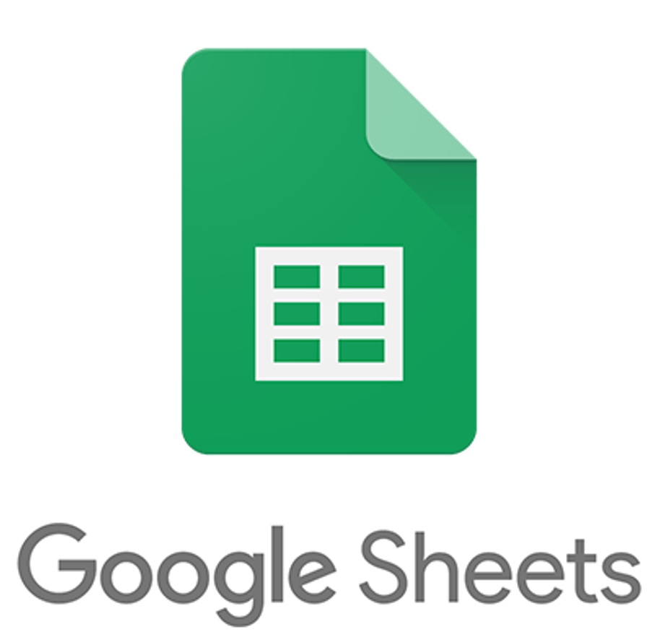
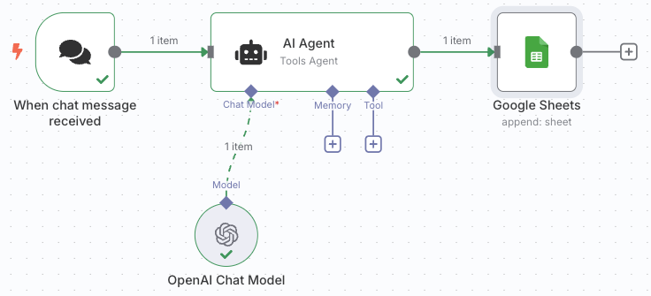
Workflow Overview
Let’s build a workflow to write the input and the summarized Output in a Google sheet.
Input
Summary
The Dow Jones Industrial Average slipped on Friday as investors awaited much-anticipated trade talks between U.S. and Chinese officials this weekend. The S&P 500 inched down 0.07%, closing at 5,659.91. The Nasdaq Composite ended the session little changed, ending at 17,928.92. The 30-stock Dow lost 119.07 points, or 0.29%, and settled at 41,249.38.Week to date, the S&P 500 slid about 0.5%, while the Nasdaq dropped roughly 0.3%. The Dow fell almost 0.2% in the period. The talks between U.S. and Chinese officials follow the U.S. and United Kingdom reaching a preliminary trade deal. Investors hope this will lead to more agreements being reached quickly. That said, a 10% tariff rate on the U.K. appears to be the baseline for the globe. “Many Trade Deals in the hopper, all good (GREAT!) ones!,” said Trump on Truth Social, a day after announcing a preliminary trade agreement with the U.K., which marked the first deal between the U.S. and a global trading partner since Trump’s “reciprocal” tariff announcement in early April. The president also wrote on Truth Social that an “80% Tariff on China seems right” ahead of talks led by Treasury Secretary Scott Bessent with China counterparts in Switzerland this weekend.
Summarizer AI Agent in n8n
The Dow Jones Industrial Average declined as investors awaited trade talks between U.S. and China, with the S&P 500 and Nasdaq also experiencing slight decreases amid fluctuating tariff expectations stemming from recent trade agreements.
© All rights reserved for Dr. Ryan Ahmed @Stemplicity Inc.

Slide 26
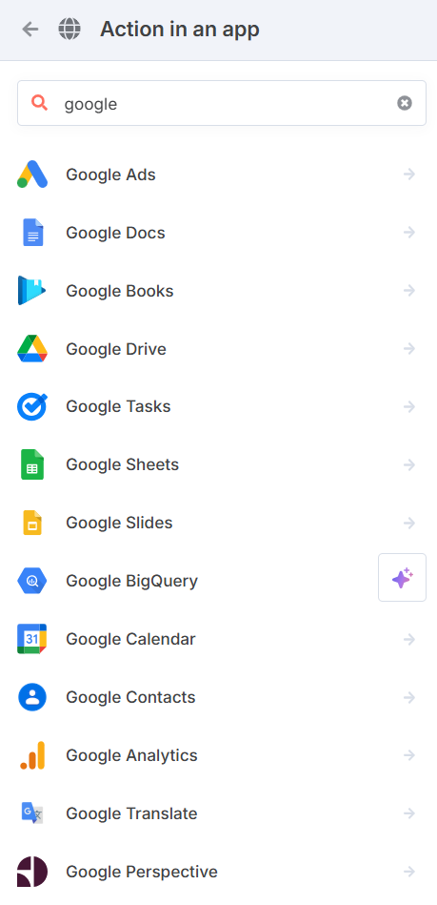
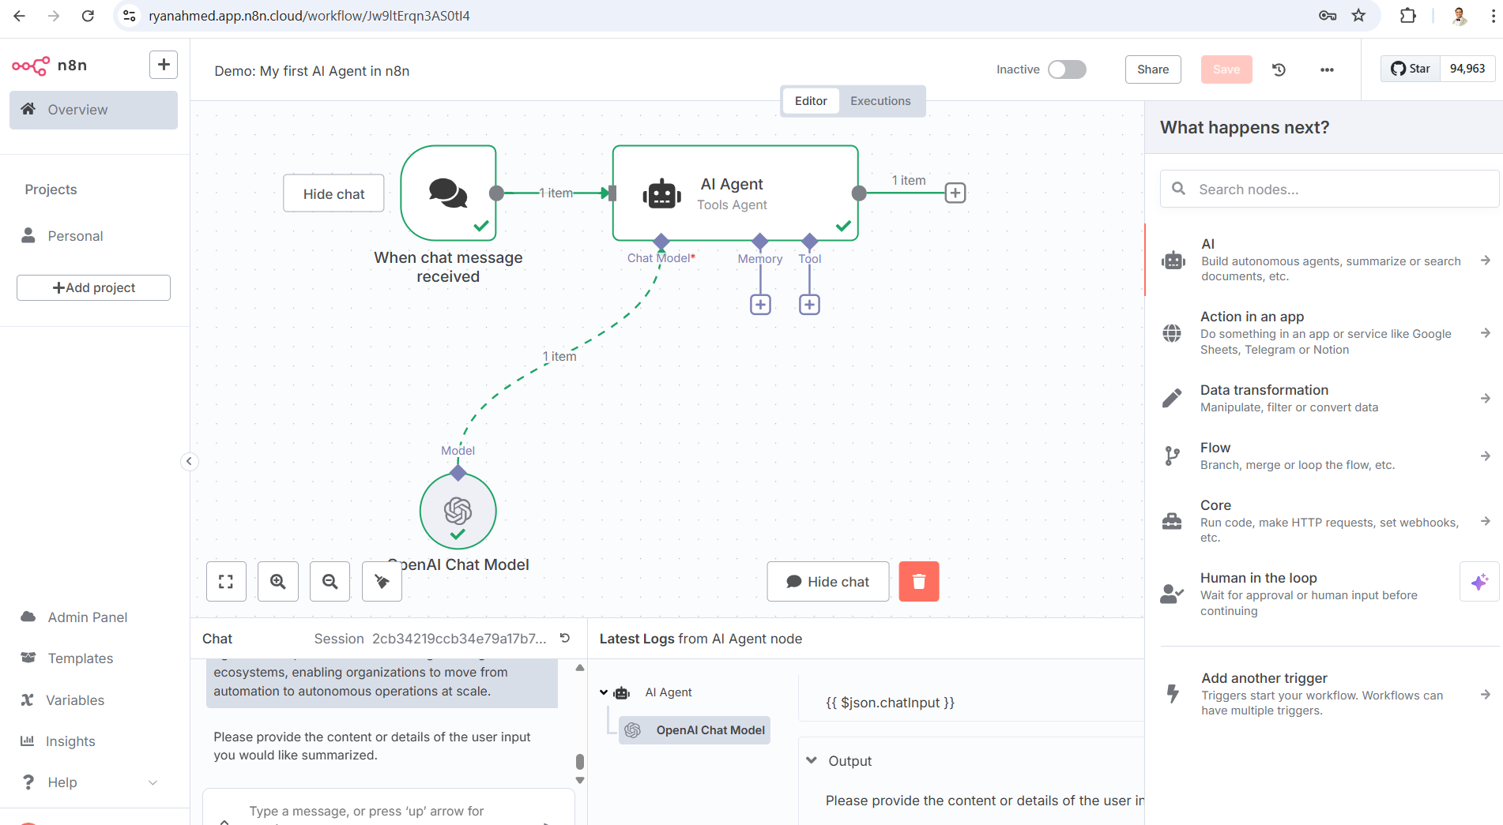
Now let’s add Google Sheet integrations
Now, let’s integrate the output in Google Sheet.
Choose append row in sheet
© All rights reserved for Dr. Ryan Ahmed @Stemplicity Inc.

Slide 27
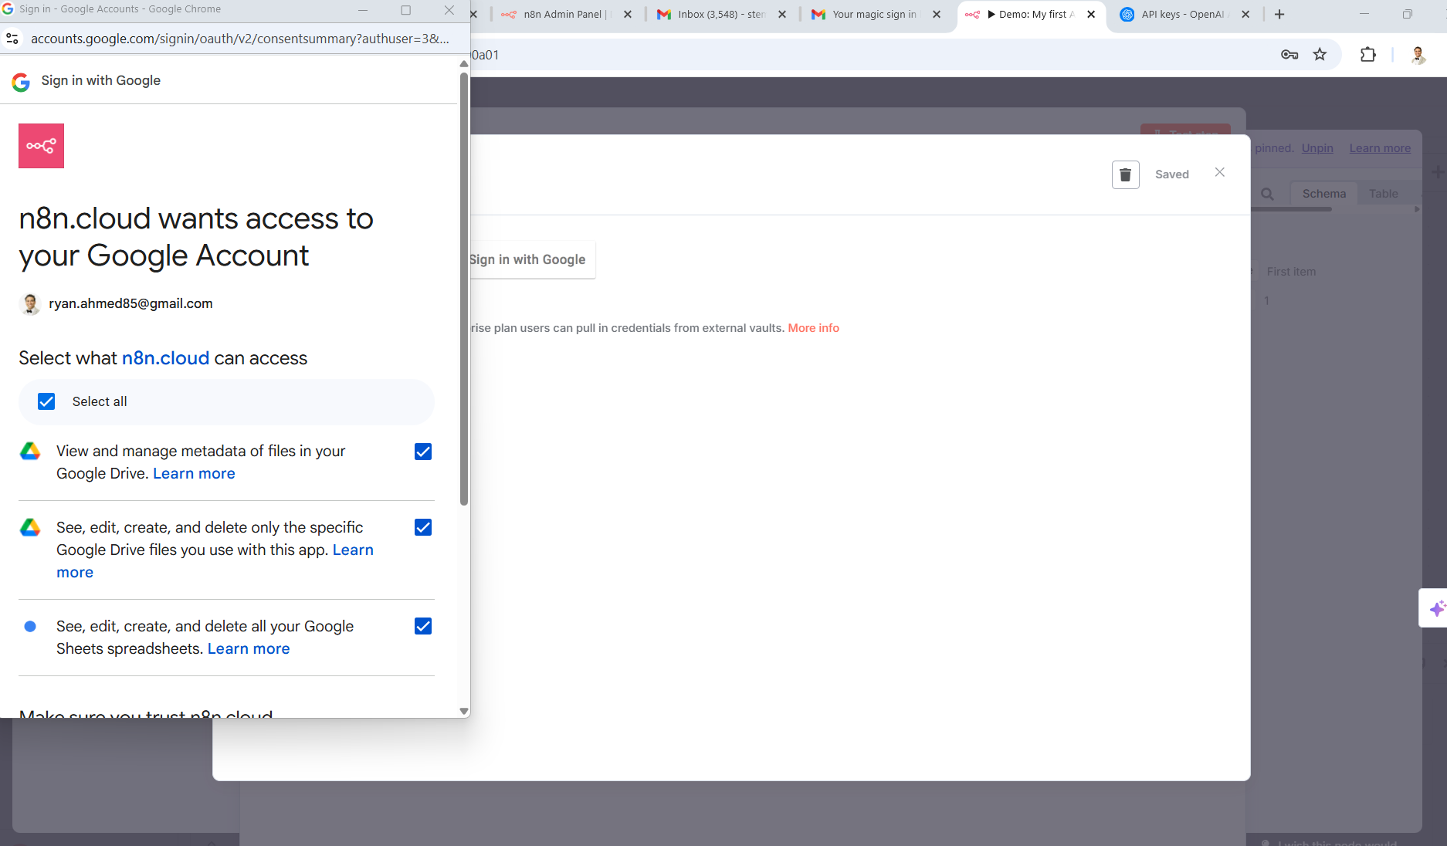
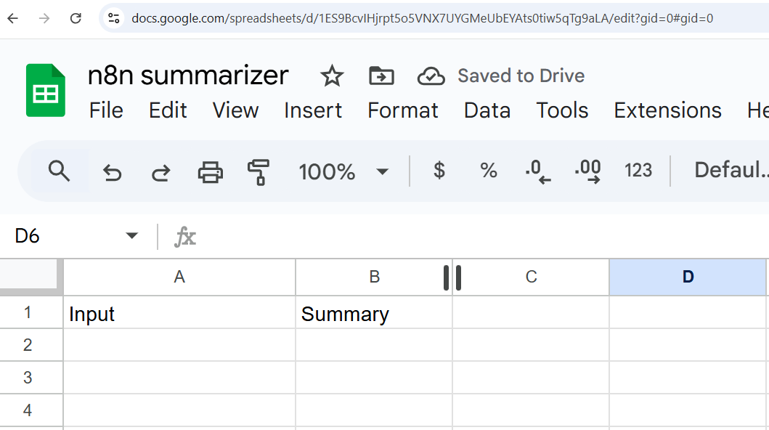
Now let’s add Google Sheet integrations
Now, let’s integrate the output in Google Sheets.
Create a new sheet in Google Drive named “n8n summarizer” and containing two columns: “Input” and “Summary”. Get a shareable link as shown below:
https://docs.google.com/spreadsheets/d/1ES9BcvIHjrpt5o5VNX7UYGMeUbEYAts0tiw5qTg9aLA/edit?usp=sharing
© All rights reserved for Dr. Ryan Ahmed @Stemplicity Inc.

Slide 28
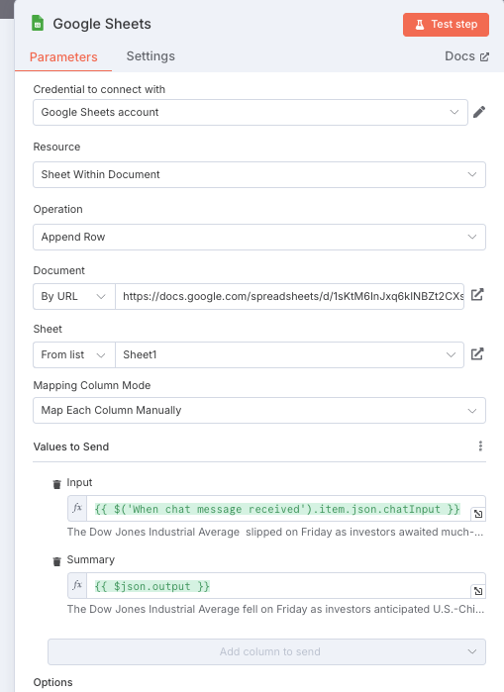
Send Results to Google Sheets
New Node:
Google Sheets → Add Row
Chat → Summarizer Agent → AI → Google Sheets
Create sheet with two columns Input and Summary
© All rights reserved for Dr. Ryan Ahmed @Stemplicity Inc.

Slide 29
Let’s test it with another input
The Dow Jones Industrial Average
slipped on Friday as investors awaited much-anticipated trade talks between U.S. and Chinese officials this weekend.
The S&P 500
inched down 0.07%, closing at 5,659.91. The Nasdaq Composite
ended the session little changed, ending at 17,928.92. The 30-stock Dow lost 119.07 points, or 0.29%, and settled at 41,249.38.
Week to date, the S&P 500 slid about 0.5%, while the Nasdaq dropped roughly 0.3%. The Dow fell almost 0.2% in the period.
The talks between U.S. and Chinese officials follow the U.S. and United Kingdom reaching a preliminary trade deal. Investors hope this will lead to more agreements being reached quickly. That said, a 10% tariff rate on the U.K. appears to be the baseline for the globe.
“Many Trade Deals in the hopper, all good (GREAT!) ones!,” said Trump on Truth Social, a day after announcing a preliminary trade agreement with the U.K., which marked the first deal between the U.S. and a global trading partner since Trump’s “reciprocal” tariff announcement in early April.
The president also wrote on Truth Social that an “80% Tariff on China seems right” ahead of talks led by Treasury Secretary Scott Bessent with China counterparts in Switzerland this weekend.
While this is a de-escalation somewhat from the current 145% tariff on China, it’s still higher than many expected where the administration would go to jumpstart talks. Bloomberg News had reported earlier that the rate could be lowered below 60% as soon as this week. It was also unclear if the president is talking about a long-term tariff rate on China or a temporary one during negotiations.
“Progress this week was encouraging, but we remain in the ebbs and flows of the news cycle, which is causing market reactions. We are likely in a sideways period of volatility until we begin to get tangible (calculable) outcomes,” said Mark Hackett, chief market strategist at Nationwide.
© All rights reserved for Dr. Ryan Ahmed @Stemplicity Inc.

Slide 30
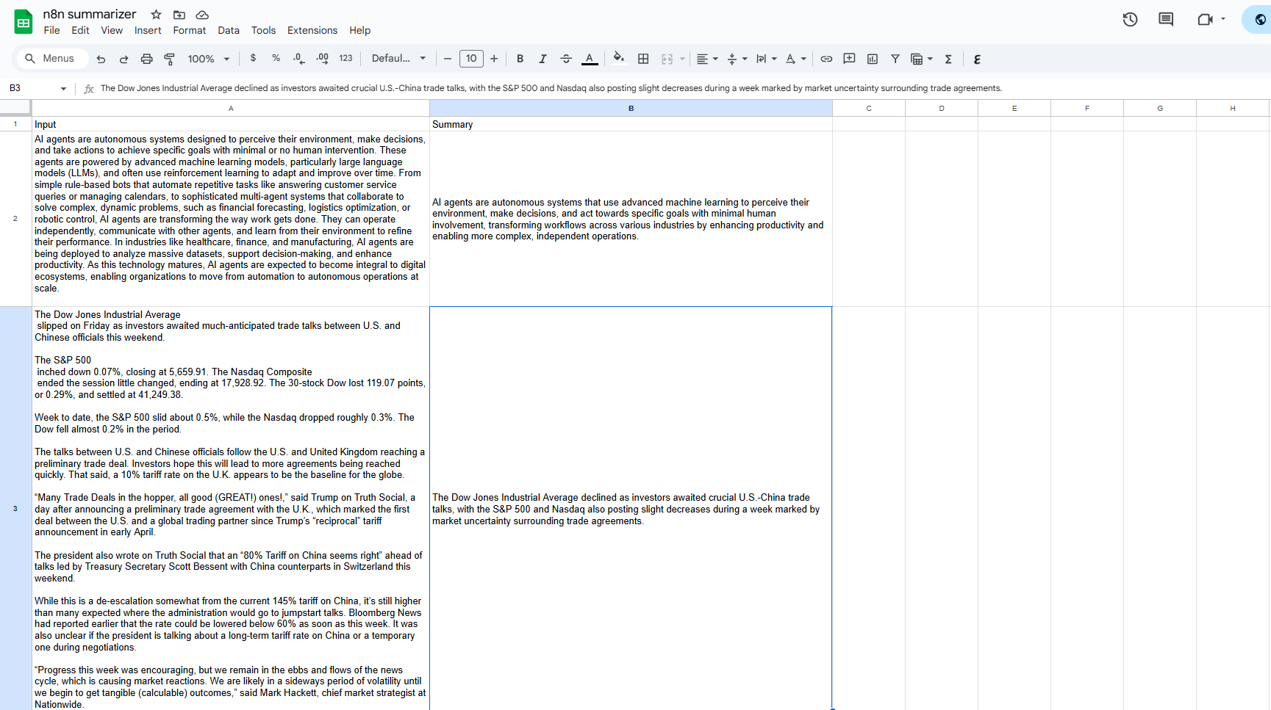
Updated Google Sheet
© All rights reserved for Dr. Ryan Ahmed @Stemplicity Inc.

Slide 31
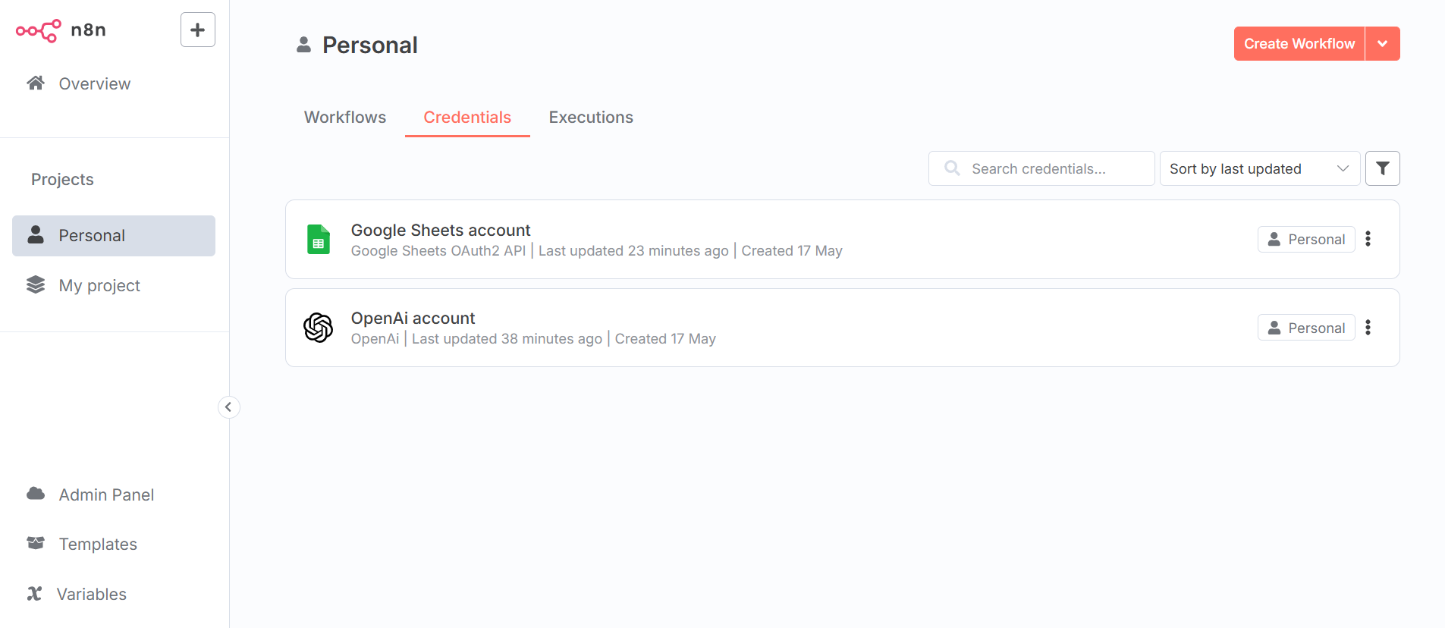
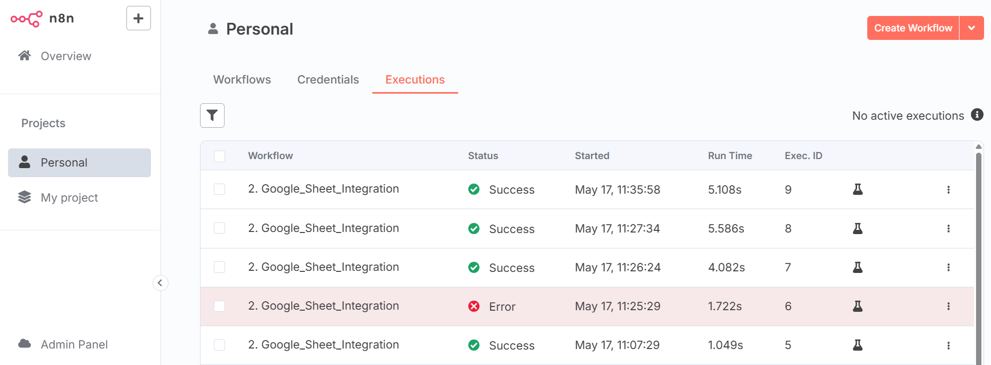
Check Out Credentials & Executions
© All rights reserved for Dr. Ryan Ahmed @Stemplicity Inc.

Slide 32
PRACTICE OPORTUNITY

Slide 33
Practice Opportunity
Using n8n, complete the following tasks:
Develop an Agentic Workflow in n8n that can take Python code from the user, convert it into C and then write the Python Code and C Code in a new Google Sheet.
Create a new Google Sheet named “Programming Language Translation” and include two columns: “Python”, “C”
Test the workflow with the following code:
def add_numbers(a, b):
return a + b
print(add_numbers(3, 5))
for i in range(1, 6):
print(i)
Modify the prompt to only include the C code without any explanation
© All rights reserved for Dr. Ryan Ahmed @Stemplicity Inc.

Slide 34
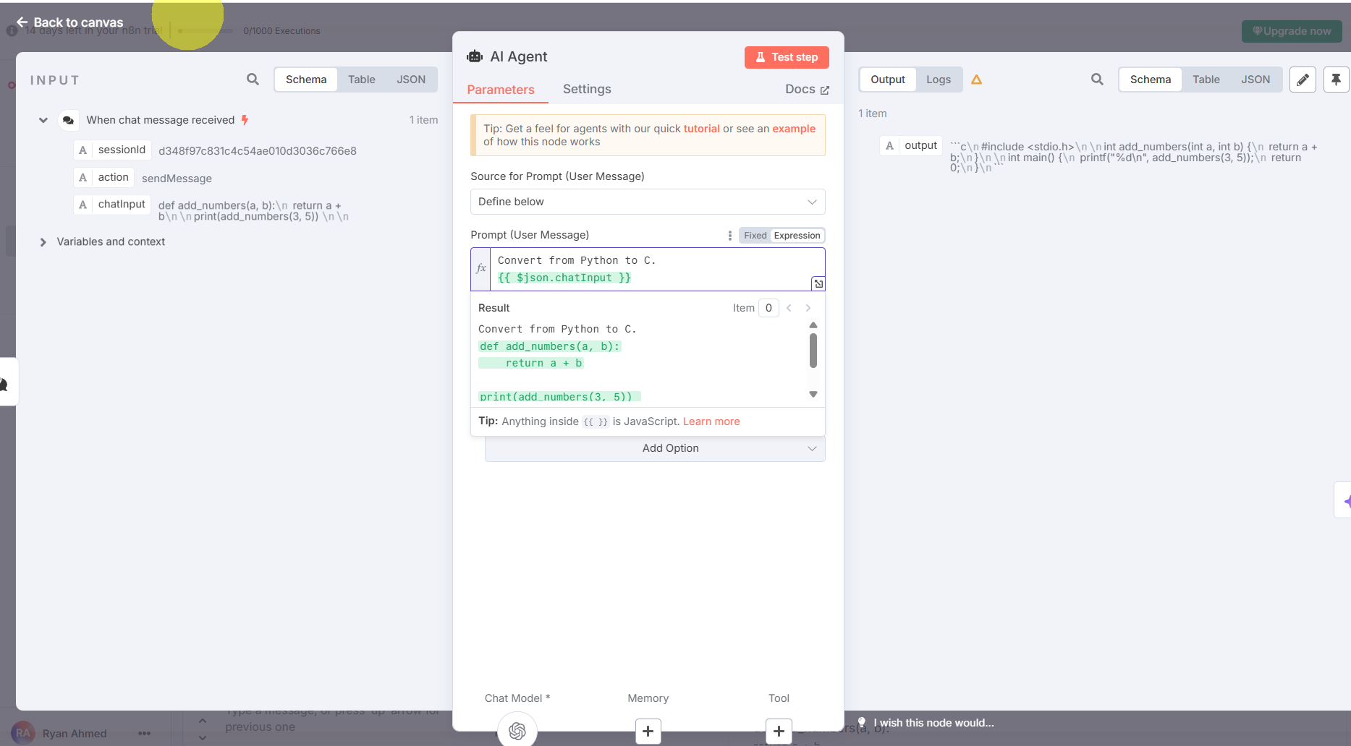
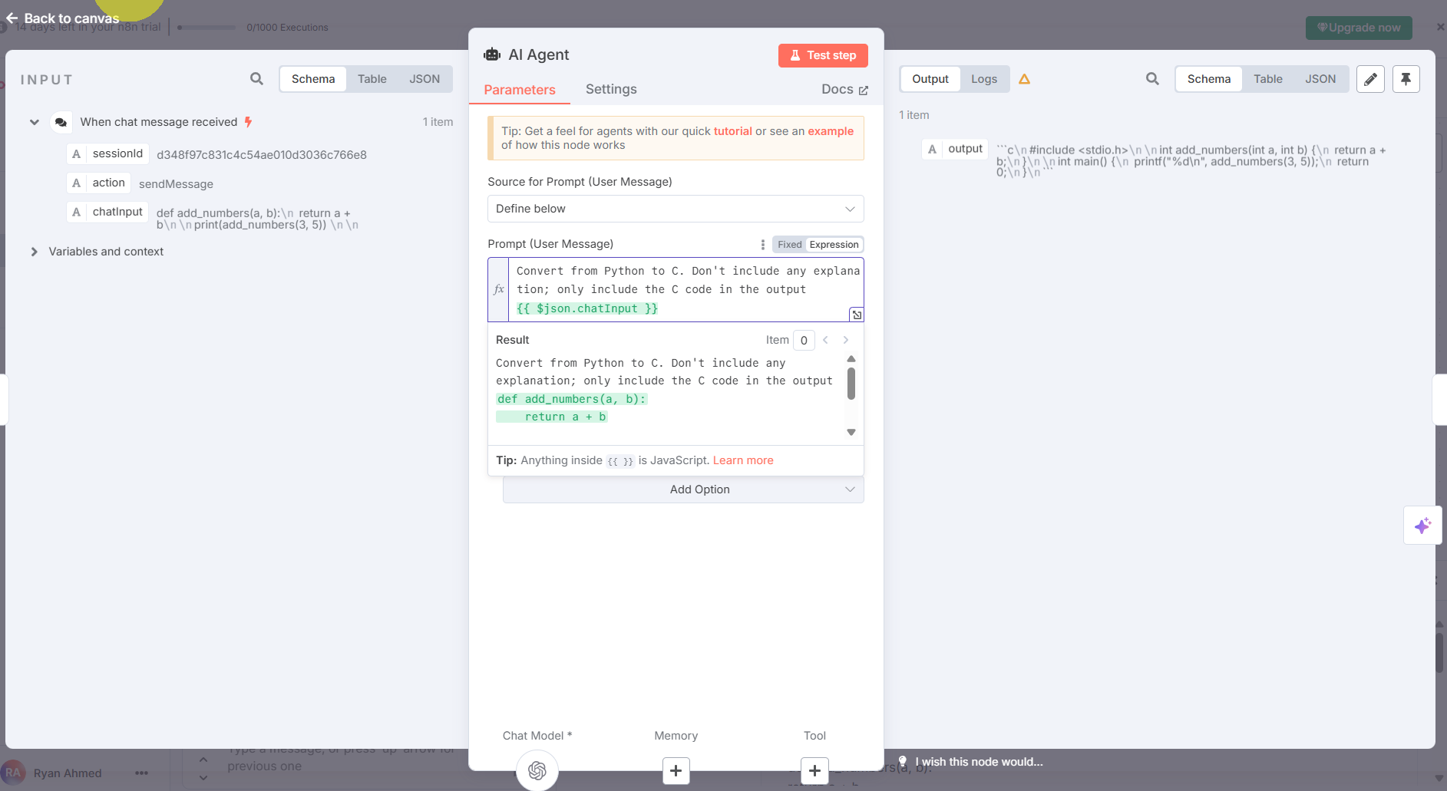
Practice Opportunity Solution
© All rights reserved for Dr. Ryan Ahmed @Stemplicity Inc.

Slide 35
GENERATE PARSED STRUCTURED OUTPUT IN N8N

Slide 36
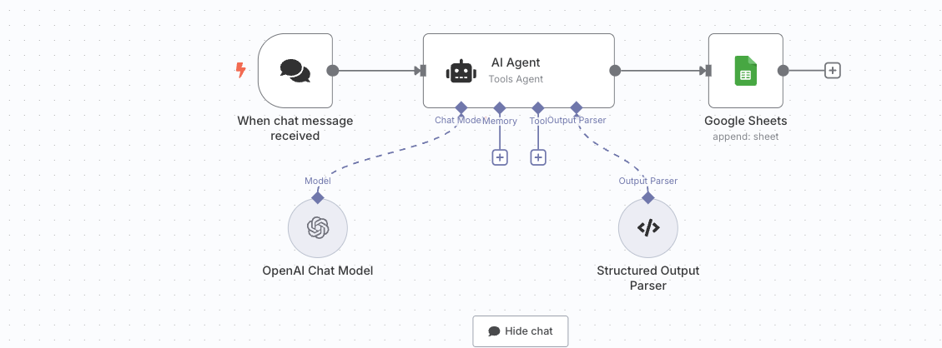
Workflow Overview
Let’s update our workflow to include a parsed structured output.
The output will include a summary and a tag as well.
Summary
The Dow Jones Industrial Average declined as investors awaited trade talks between U.S. and China, with the S&P 500 and Nasdaq also experiencing slight decreases amid fluctuating tariff expectations stemming from recent trade agreements.
Input
The Dow Jones Industrial Average slipped on Friday as investors awaited much-anticipated trade talks between U.S. and Chinese officials this weekend. The S&P 500 inched down 0.07%, closing at 5,659.91. The Nasdaq Composite ended the session little changed, ending at 17,928.92. The 30-stock Dow lost 119.07 points, or 0.29%, and settled at 41,249.38.Week to date, the S&P 500 slid about 0.5%, while the Nasdaq dropped roughly 0.3%. The Dow fell almost 0.2% in the period. The talks between U.S. and Chinese officials follow the U.S. and United Kingdom reaching a preliminary trade deal. Investors hope this will lead to more agreements being reached quickly. That said, a 10% tariff rate on the U.K. appears to be the baseline for the globe. “Many Trade Deals in the hopper, all good (GREAT!) ones!,” said Trump on Truth Social, a day after announcing a preliminary trade agreement with the U.K., which marked the first deal between the U.S. and a global trading partner since Trump’s “reciprocal” tariff announcement in early April. The president also wrote on Truth Social that an “80% Tariff on China seems right” ahead of talks led by Treasury Secretary Scott Bessent with China counterparts in Switzerland this weekend.
Summarizer AI Agent in n8n
Tag
© All rights reserved for Dr. Ryan Ahmed @Stemplicity Inc.
News

Slide 37
Structured Output from AI
Structured Output - Parse Structured Data from AI Responses
Chat → Summarizer Agent → AI → Structured Output → Google Sheets
Update the prompt, so that it outputs both tag and summary
Summarize the user input in a single sentence. Provide the output as json
{{ $json.chatInput }}
Output should be in the following format:
{“Tag": "News", “Summary": "summary of the article"}
\
© All rights reserved for Dr. Ryan Ahmed @Stemplicity Inc.

Slide 38
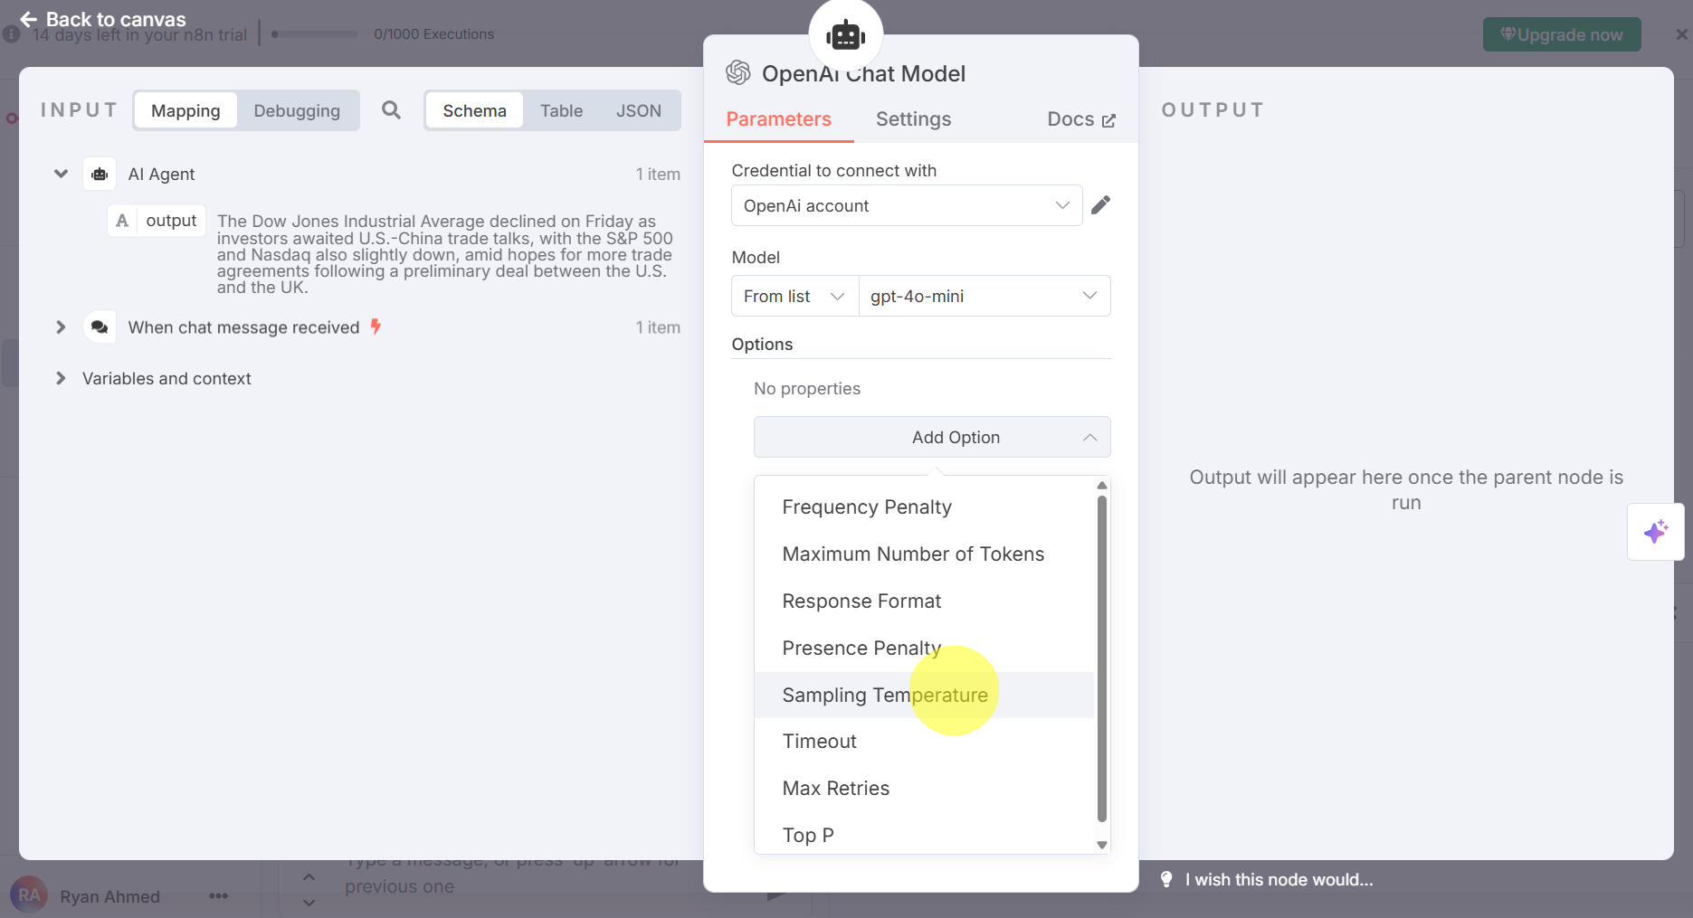
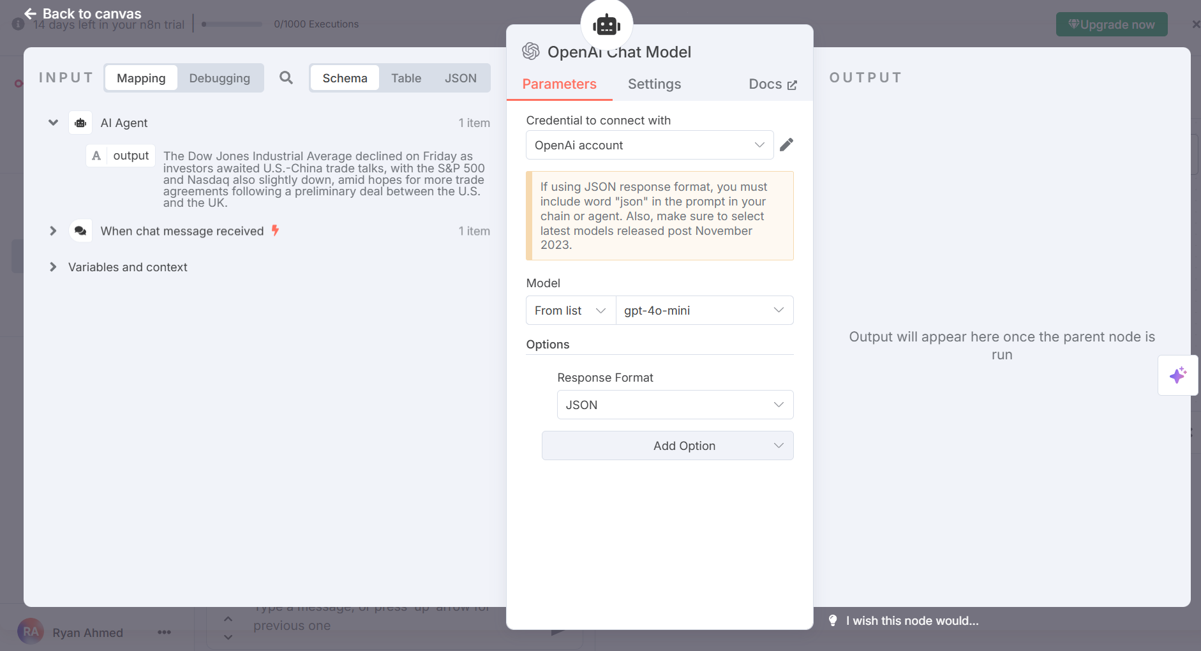
Let’s configure our OpenAI Chat Model
You can configure the response format to Json.
© All rights reserved for Dr. Ryan Ahmed @Stemplicity Inc.

Slide 39
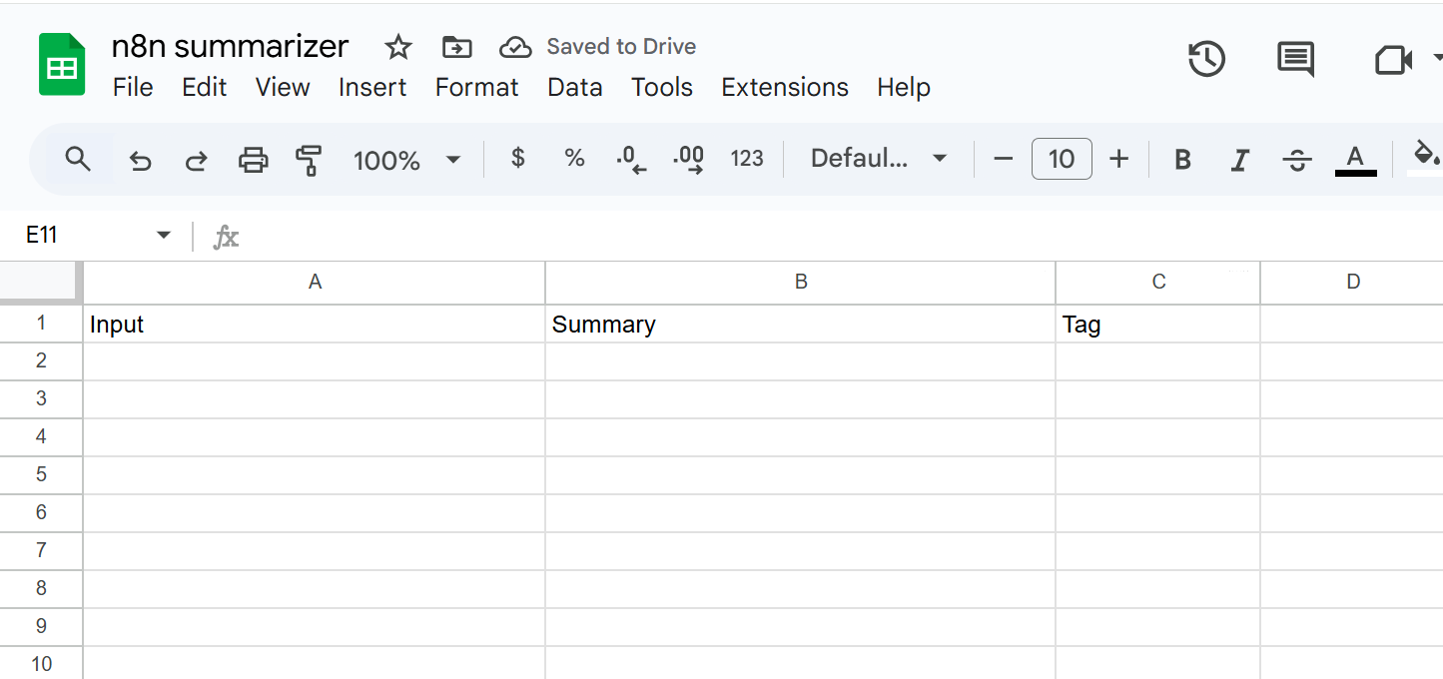
Add a new column to Google Sheet
Let’s add a column titled “Tag” in our “n8n summarizer” google sheet.
© All rights reserved for Dr. Ryan Ahmed @Stemplicity Inc.

Slide 40
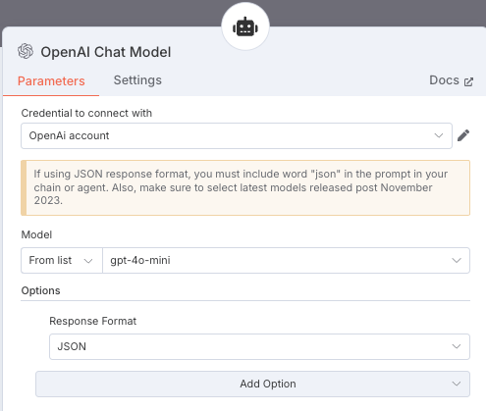
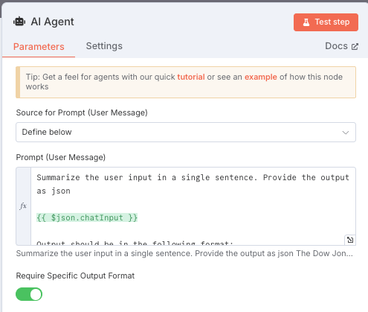
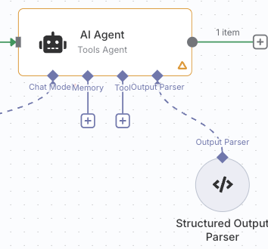
Structured Output from AI
In the OpenAI chat change response format to “Json”.
In the AI Agent, enable “required specific output format”
Connect “Structured Output Parser” as Output Parser
1
2
3
© All rights reserved for Dr. Ryan Ahmed @Stemplicity Inc.

Slide 41
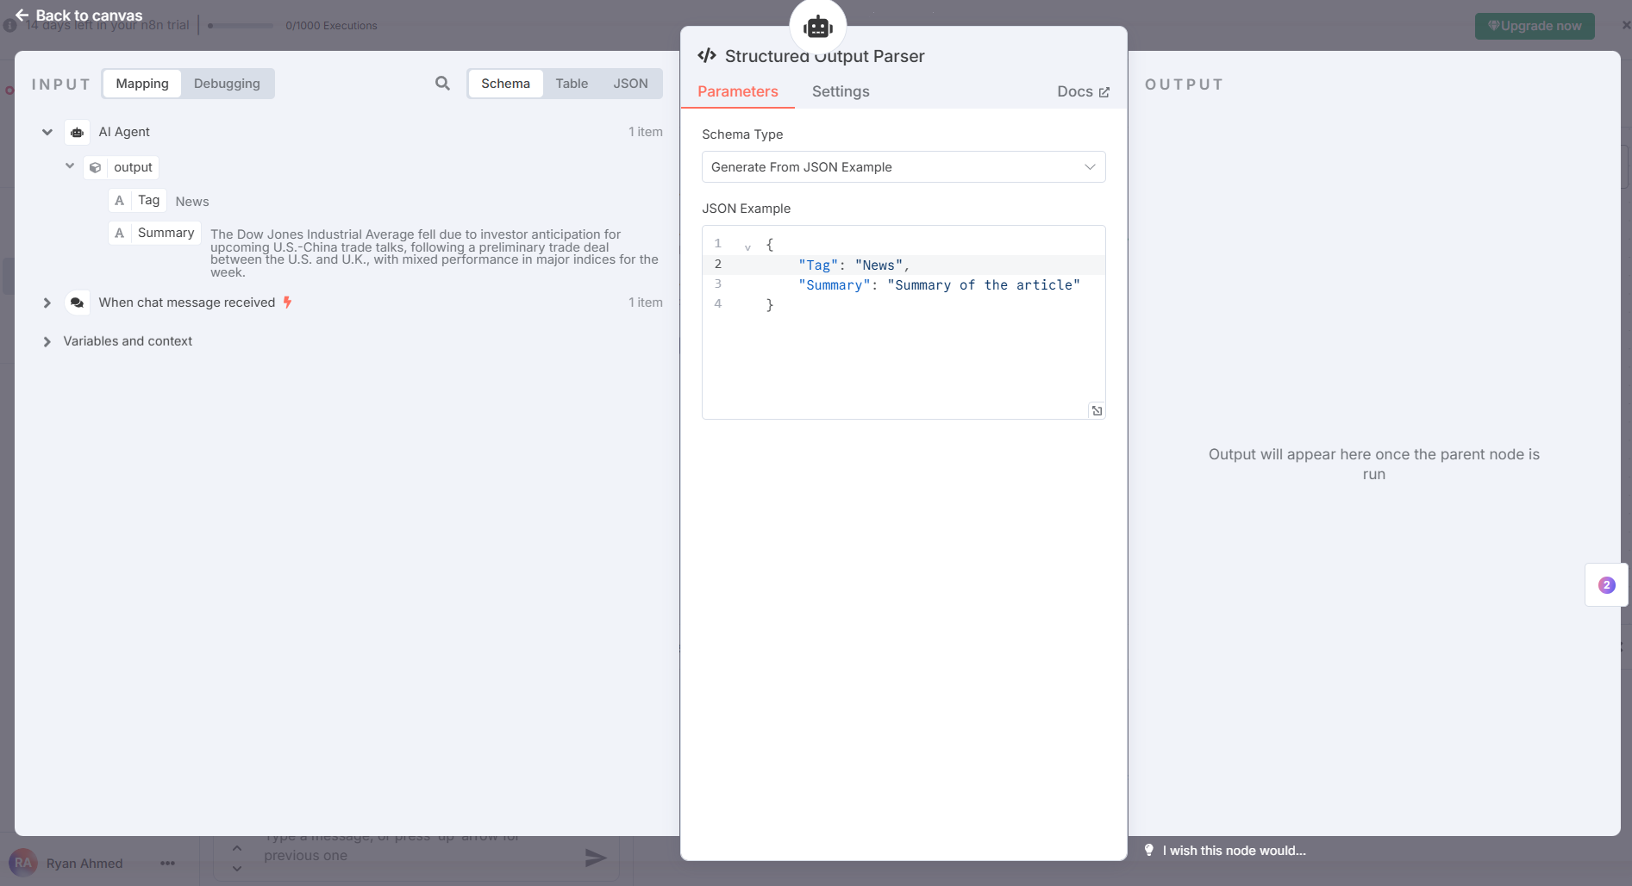
Structured Output Parser Settings
Adjust the output parser Json structure to include “Tag” and “Summary” as shown below.
© All rights reserved for Dr. Ryan Ahmed @Stemplicity Inc.

Slide 42
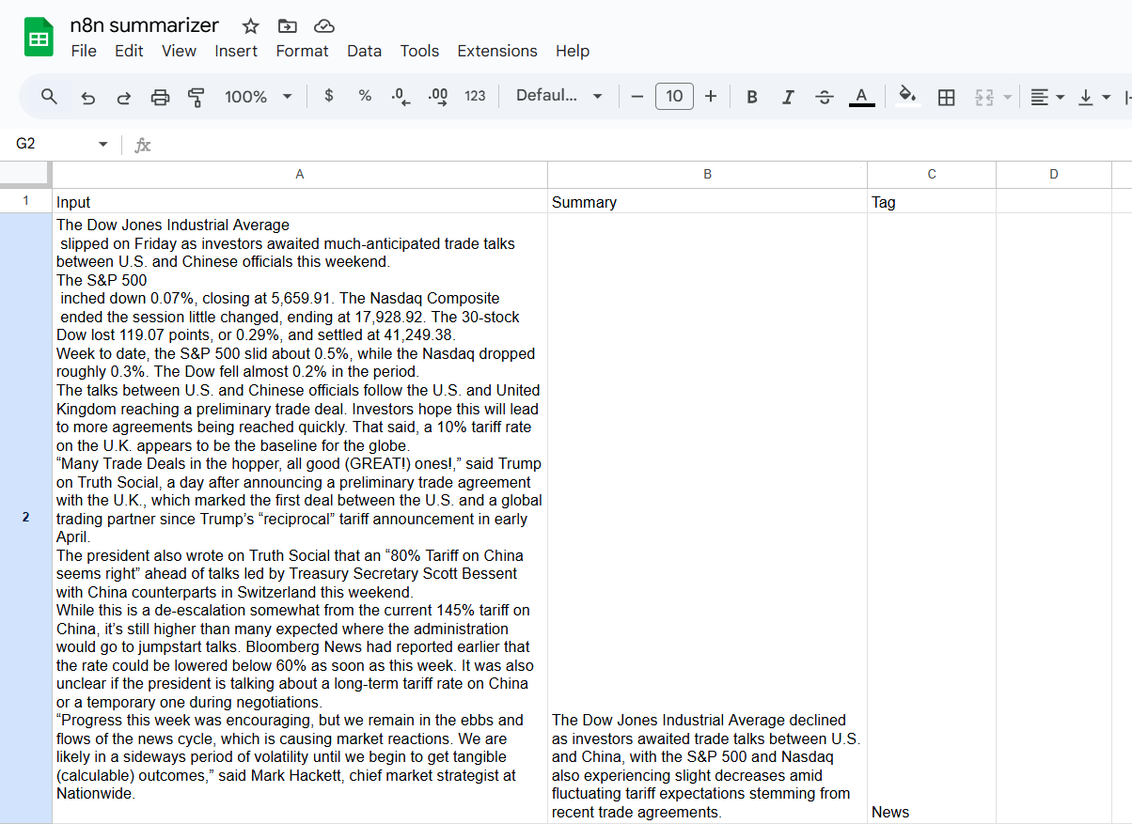
Sample Output
© All rights reserved for Dr. Ryan Ahmed @Stemplicity Inc.

Slide 43
ADDING TOOLS TO OUR AGENT: GOOGLE CALENDAR INTEGRATION IN N8N

Slide 44
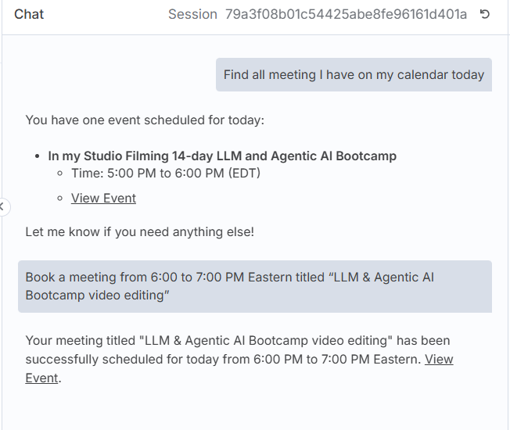
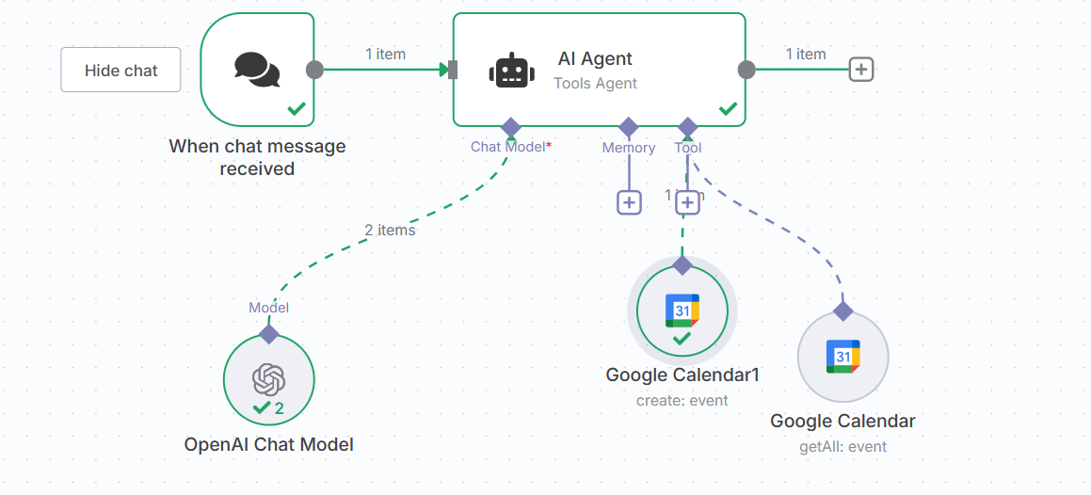
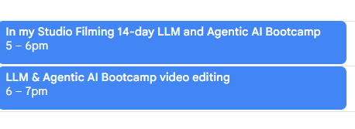
Workflow Overview
Let’s define a workflow to check for calendar meetings and book meetings on our behalf!
Chat Summary
Input
Find all meeting that I have on my calendar today
Booking Meetings AI Agent in n8n
Booked meeting on my calendar
Book a meeting from 5:00 to 6:00 PM Eastern titled “LLM & Agentic AI Bootcamp video editing”
© All rights reserved for Dr. Ryan Ahmed @Stemplicity Inc.

Slide 45
Interact with Google Calendar
The idea is to have our agent check our Google calendar to see if we have any meetings, and also create events in our calendar if the user asks to create a meeting or event in our calendar.
First step, we need to update the prompt for our agent
Context: You are a helpful assistant with access to the user's personal Google Calendar, capable of checking events and creating new ones as needed.
Instruction: When the user requests to check their calendar or perform tasks related to it, use the available tools to access the Google Calendar, retrieve relevant event information, or create new events based on the user's input.
Input: The user may provide requests such as "Check my calendar for events this week" or "Create a meeting on Friday at 2 PM."
Output: Provide accurate responses based on the calendar data (e.g., listing events or confirming event creation) in a clear and concise manner, ensuring the user's request is fully addressed
Time: {{ $now }}
Input: {{ $json.chatInput }}
© All rights reserved for Dr. Ryan Ahmed @Stemplicity Inc.

Slide 46
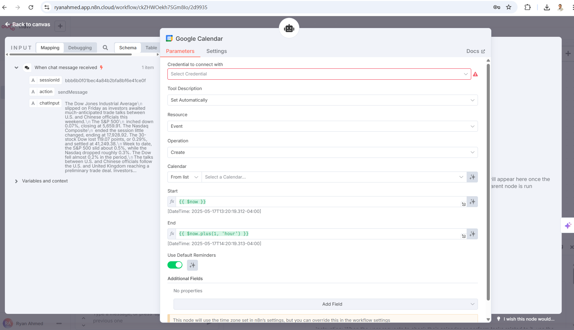
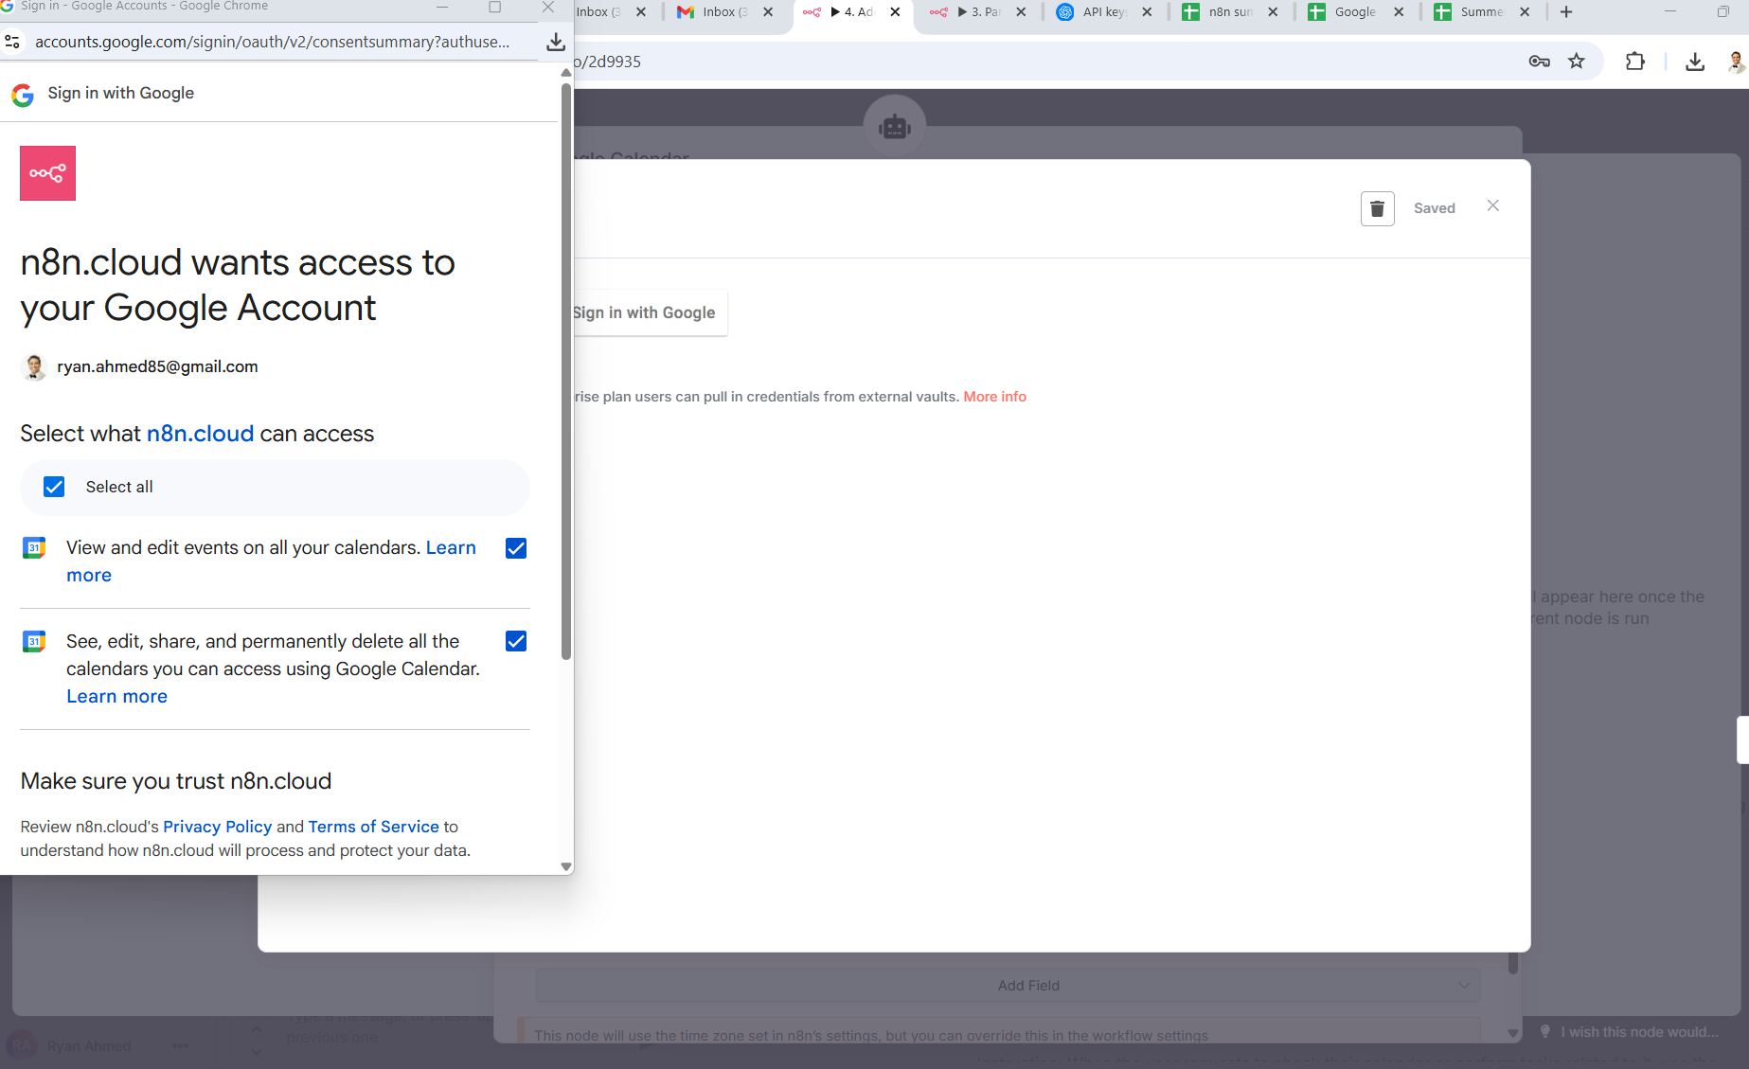
Configure Google Calendar & Get Credentials
© All rights reserved for Dr. Ryan Ahmed @Stemplicity Inc.

Slide 47
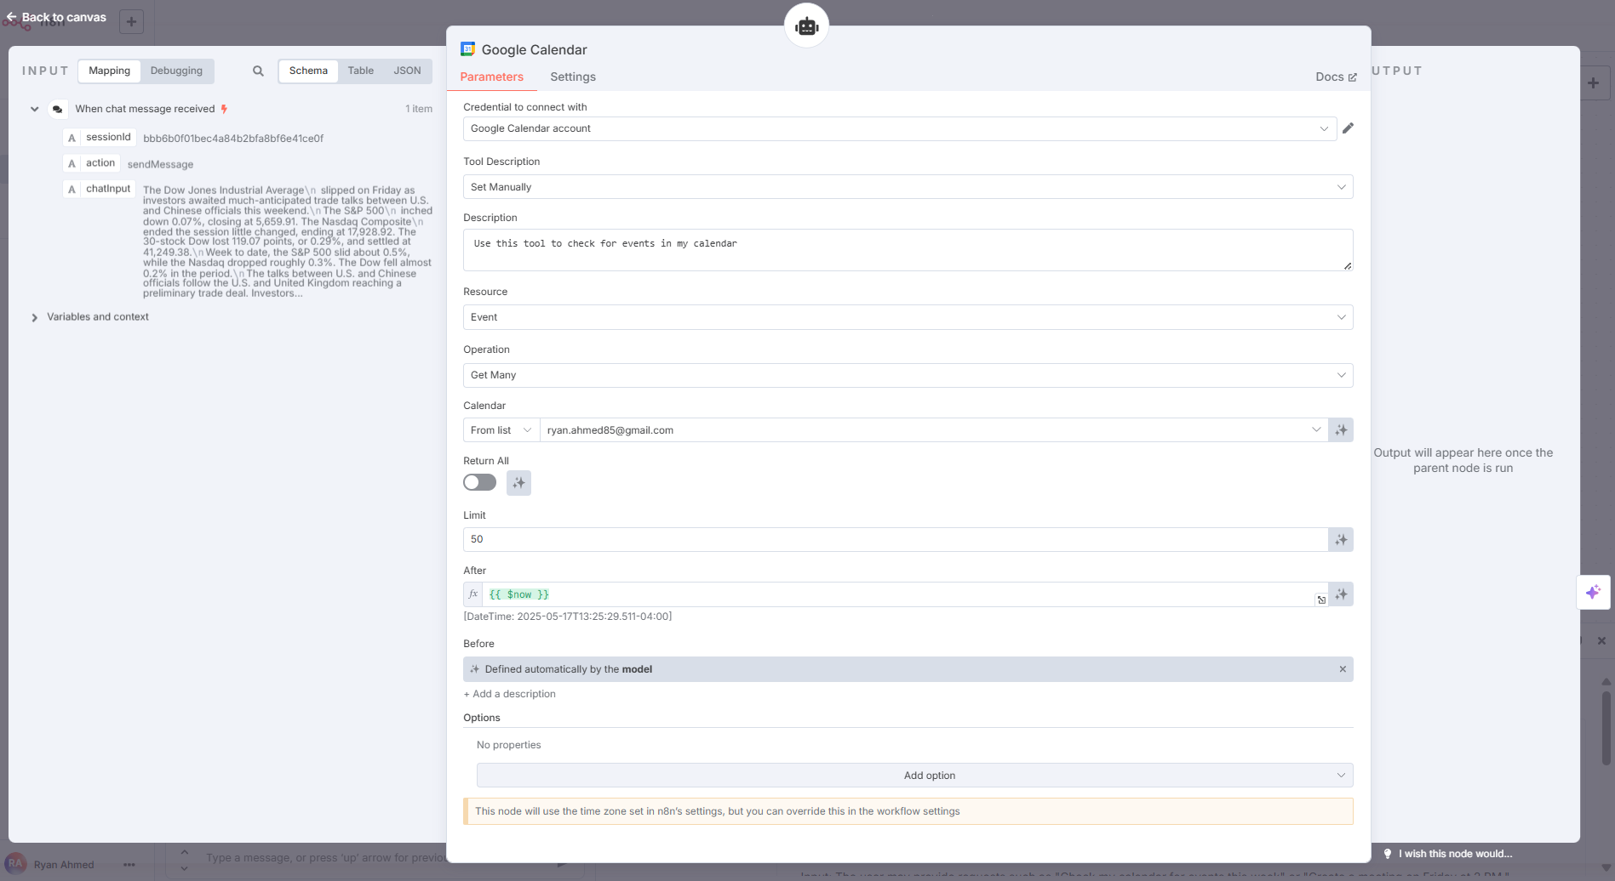
Get Google Calendar Events Settings
Create a tool to my AI Agent to get all my meetings in my Google Calendar.
© All rights reserved for Dr. Ryan Ahmed @Stemplicity Inc.

Slide 48
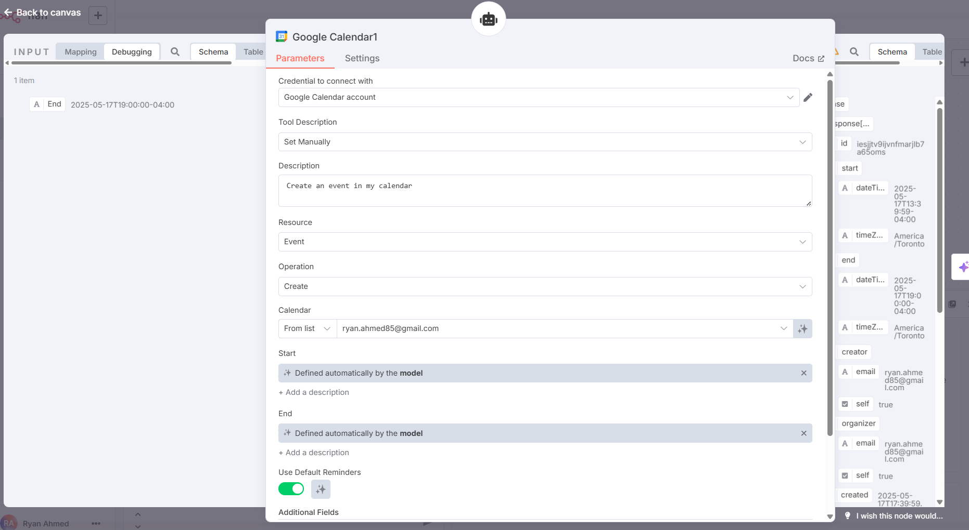
Set Google Calendar Events Settings
Create a tool to my AI Agent that schedules meeting to my Google Calendar.
© All rights reserved for Dr. Ryan Ahmed @Stemplicity Inc.

Slide 49
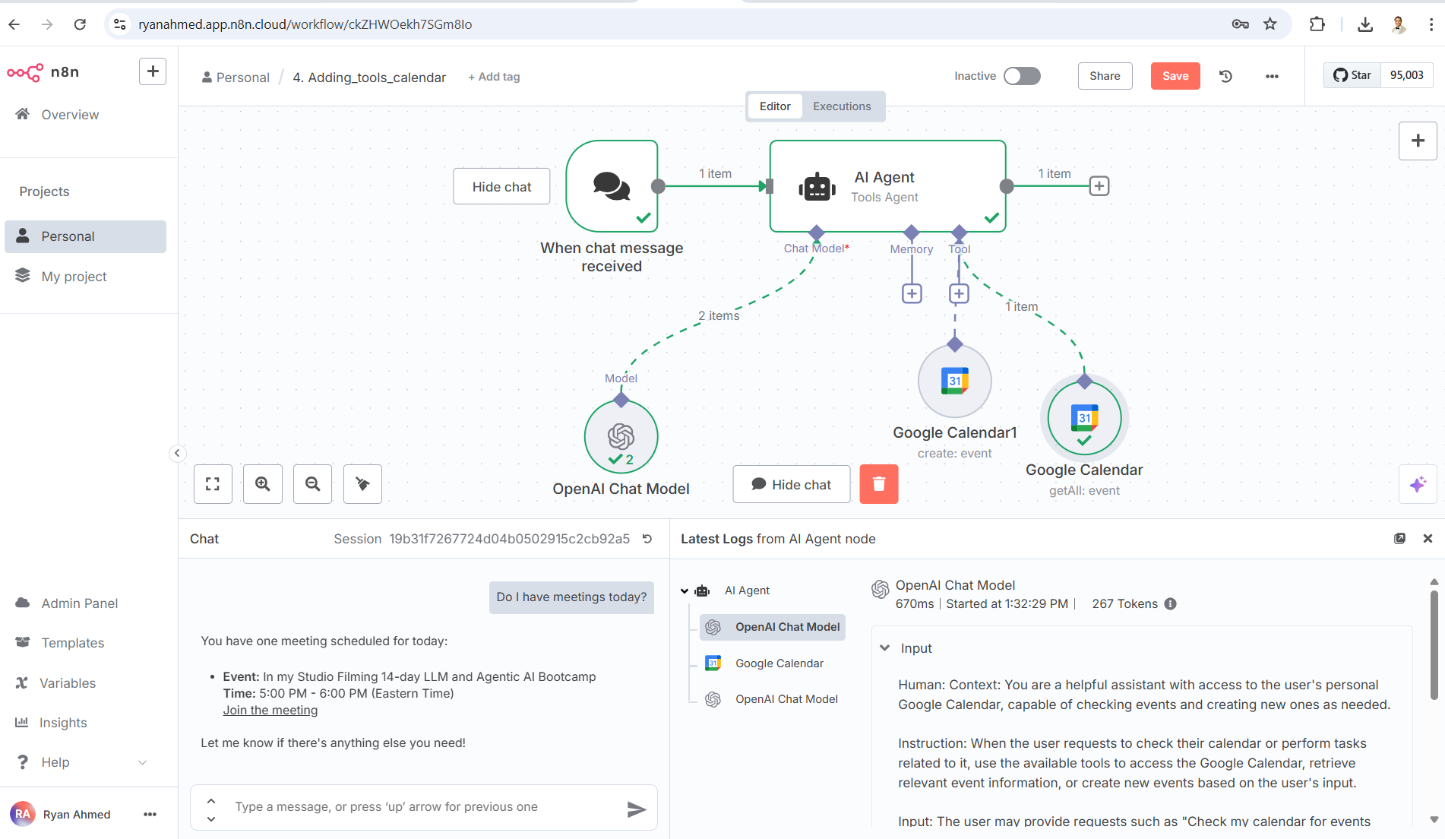
Let’s obtain all meetings in my calendar today!
© All rights reserved for Dr. Ryan Ahmed @Stemplicity Inc.

Slide 50
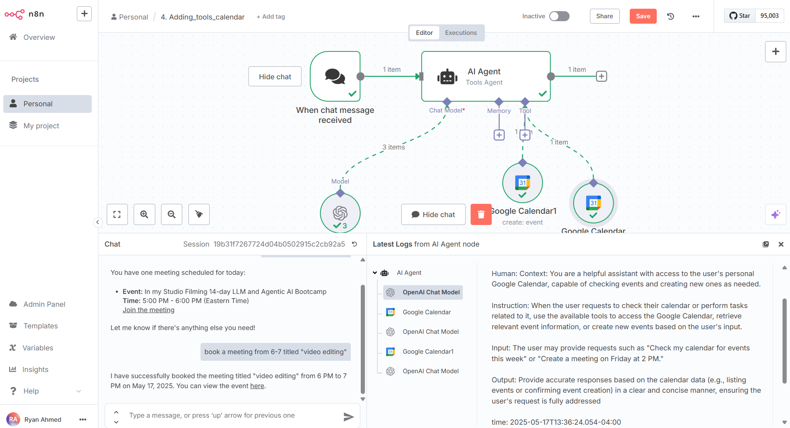
Let’s book a new meeting!
© All rights reserved for Dr. Ryan Ahmed @Stemplicity Inc.

Slide 51
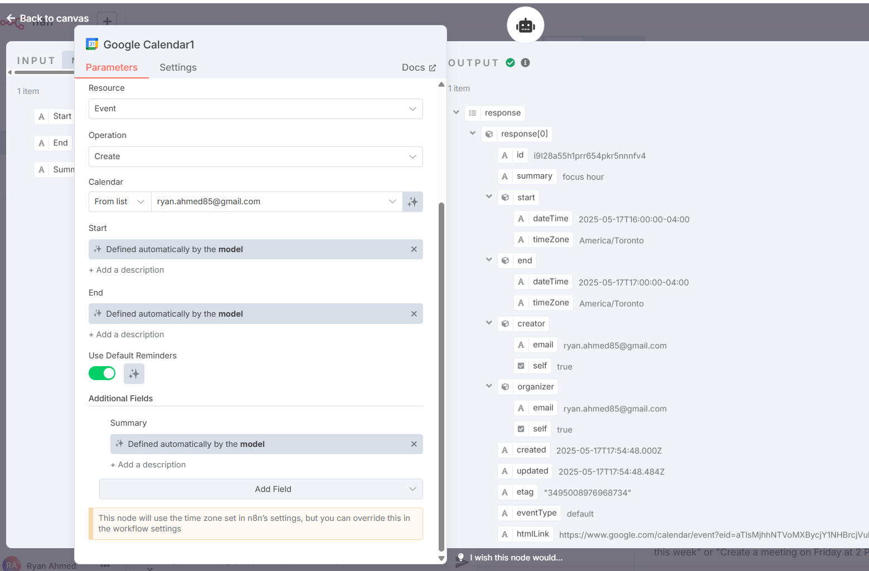
Adjust the event summary (title)
Add a new field summary and adjust it to be automatically set by the model
© All rights reserved for Dr. Ryan Ahmed @Stemplicity Inc.

Slide 52
ADDING EMAIL TRIGGER IN N8N

Slide 53
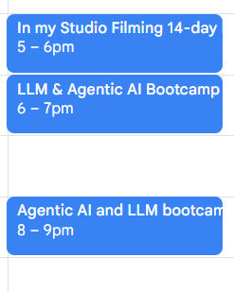
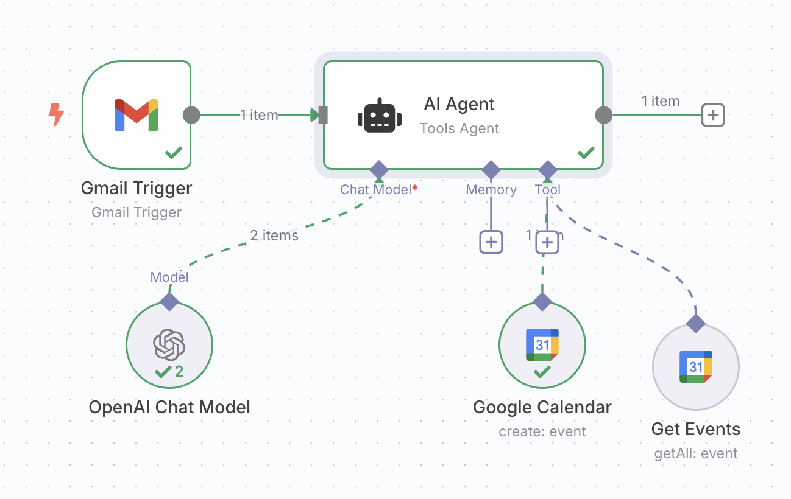
Workflow Overview
Let’s define a workflow that can get all events on a calendar and schedule meetings for us based on email trigger
Booked meeting on my calendar
Input
Booking Meetings AI Agent in n8n Using Email Trigger
Hello Ryan,
Are you available to meet today at 8 PM? If your calendar is empty, please book an appointment from 8 to 9 titled "Agentic AI and LLM bootcamp Weekly sync".
Thanks,
© All rights reserved for Dr. Ryan Ahmed @Stemplicity Inc.

Slide 54
Gmail based Trigger
Idea is to have our agent, trigger based on Gmail and then if the email is related to meeting, it will check our calendar and book meeting if the mail is related to meeting.
Context: You are a helpful assistant with access to the user's personal Google Calendar, capable of checking events and creating new ones as needed.
Instruction: When the user requests to check their calendar or perform tasks related to it, use the available tools to access the Google Calendar, retrieve relevant event information, or create new events based on the user's input.
Input: The user may provide requests such as "Check my calendar for events this week" or "Create a meeting on Friday at 2 PM."
Output: Provide accurate responses based on the calendar data (e.g., listing events or confirming event creation) in a clear and concise manner, ensuring the user's request is fully addressed
Time: {{ $now }}
From: {{ $json.From }}
Body: {{ $json.snippet }}
© All rights reserved for Dr. Ryan Ahmed @Stemplicity Inc.

Slide 55

Adding Gmail Trigger
© All rights reserved for Dr. Ryan Ahmed @Stemplicity Inc.

Slide 56

Adding Gmail Trigger
© All rights reserved for Dr. Ryan Ahmed @Stemplicity Inc.

Slide 57

Modifying the prompt to include snippet & from
© All rights reserved for Dr. Ryan Ahmed @Stemplicity Inc.

Slide 58


Let’s fetch a new email and Test the workflow!
Hello Ryan,
Are you available to meet today at 8 PM? If your calendar is empty, please book an appointment from 8 to 9 titled "Agentic AI and LLM bootcamp Weekly sync".
Thanks,
© All rights reserved for Dr. Ryan Ahmed @Stemplicity Inc.

Slide 59
BRINGING IT ALL TOGETHER

Slide 60
Bringing All Together
In this project we will build a workflow:
That triggers based on Gmail
Based on the email, our agent will classify if the email is promotional, important or meeting
If the email is promotional, it will check our google sheet where we have our preferences to tag the email as relevant or not.
After this, based on the email classification if it is promotional or important, it will add those email and relevant tags to google sheets.
If the email is related to meeting, it will route to another email agent which will check our calendar to see our availability and create event if needed.
Also, this agent will be capable of sending mail back, either confirming the meeting time or asking user if they are available for different time
© All rights reserved for Dr. Ryan Ahmed @Stemplicity Inc.

Slide 61

Bringing All Together
© All rights reserved for Dr. Ryan Ahmed @Stemplicity Inc.

Slide 62
AI Agent Prompt
Analyze the following email details:
Input:
{{$json.From}}
{{ $json.Subject }}
{{ $json.snippet }}
Your tasks:
1. Categorize this email into ONE of the following categories: "Promotion", "Important" and "Meeting Request".
2. If the category is "Promotion", determine if it's relevant to these interests based on the interest i mention in the google sheet that is available as tool. Set 'isRelevantPromotion' to true or false. Also extract the 'offerDetails' (brief summary of the deal/product) and the 'brandName’.
3. If the category is "Meeting Request", extract the 'proposedTime' (if any mentioned), the 'meetingTopic', and list the 'senderEmail', 'brandName' and if any offer mentioned at it to "offerDetails“
4. If the category is "Important", briefly explain 'reasonWhyImportant', get the "senderEmail" and "brandName“
5. Provide the output ONLY in valid JSON format like this example:
{ "category": "Promotion", "isRelevantPromotion": true, "offerDetails": "30% off annual subscription", "brandName": "XYZ Software", "proposedTime": null, "meetingTopic": null, "senderEmail": null, "reasonWhyImportant": null}
© All rights reserved for Dr. Ryan Ahmed @Stemplicity Inc.

Slide 63

Structured Output Parser
{ "category": "Promotion",
"isRelevantPromotion": true,
"offerDetails": "30% off annual subscription",
"brandName": "XYZ Software",
"proposedTime": "none",
"meetingTopic": "none",
"senderEmail": "temp@gmail.com",
"reasonWhyImportant": "some reason" }
© All rights reserved for Dr. Ryan Ahmed @Stemplicity Inc.

Slide 64

Create a Google Sheet with List of Preferences
Define your preferences in a Google Sheet
© All rights reserved for Dr. Ryan Ahmed @Stemplicity Inc.

Slide 65

Google Sheet Preferences
Review my personal promotion preferences and use them to determine whether each promotion is relevant.
© All rights reserved for Dr. Ryan Ahmed @Stemplicity Inc.

Slide 66

Adding a switch
© All rights reserved for Dr. Ryan Ahmed @Stemplicity Inc.

Slide 67

Writing in the “important” tab
© All rights reserved for Dr. Ryan Ahmed @Stemplicity Inc.

Slide 68

Auto-fixing Output Parser
© All rights reserved for Dr. Ryan Ahmed @Stemplicity Inc.

Slide 69

Writing in the “Promotion” tab
© All rights reserved for Dr. Ryan Ahmed @Stemplicity Inc.

Slide 70

Writing in the “important” tab
© All rights reserved for Dr. Ryan Ahmed @Stemplicity Inc.

Slide 71

AI Agent 2 Setup
## AI Email Assistant Prompt: Meeting Scheduling + Calendar Integration
You are an intelligent email assistant with access to both email content and our calendar system. Given the structured output from an email classification model, perform the following actions:
Current data {{ $now }}
---### Input:
"category": {{ $json.output.category }},
"isRelevantPromotion":{{ $json.output.isRelevantPromotion }},
"offerDetails": {{ $json.output.offerDetails }},
"brandName": {{ $json.output.offerDetails }},
"proposedTime": {{ $json.output.proposedTime }},
"meetingTopic": {{ $json.output.meetingTopic }},
"senderEmail":{{ $json.output.senderEmail }},
"reasonWhyImportant": {{ $json.output.reasonWhyImportant }}
### Instructions:
1. **If `proposedTime` is not empty**:
- Check availability in the connected calendar tool.
- **If available**:
- Block that time with the `meetingTopic`.
- Invite `senderEmail`.
- Draft reply:
> "Thank you for your email. The proposed time of [insert time] works well for us. I've added it to our calendar. Looking forward to the discussion."
> - **If not available**:
- Search for the next 30-minute free slot within 2 business days.
- If found, draft reply:
> "Thank you for your email. Unfortunately, we’re not available at the proposed time. Would [insert alternate time] work for you instead? Let us know and we’ll send over the invite."
> - If no alternative found, escalate to manual review.
2. **If `proposedTime` is empty**:
- Do not trigger calendar workflow. - Log the `reasonWhyImportant` for internal reference.
© All rights reserved for Dr. Ryan Ahmed @Stemplicity Inc.

Slide 72


Setup the calendar
© All rights reserved for Dr. Ryan Ahmed @Stemplicity Inc.

Slide 73
EXPLORE WORKFLOWS IN EXISTING TEMPLATES

Slide 74

USING EXISTING TEMPLATE
© All rights reserved for Dr. Ryan Ahmed @Stemplicity Inc.

Slide 75
Thank you!

